Slide 1
DATA STRUCTURES USING ‘C’
Unit iii : Stacks and Queues
Weightage -20 marks

Slide 2
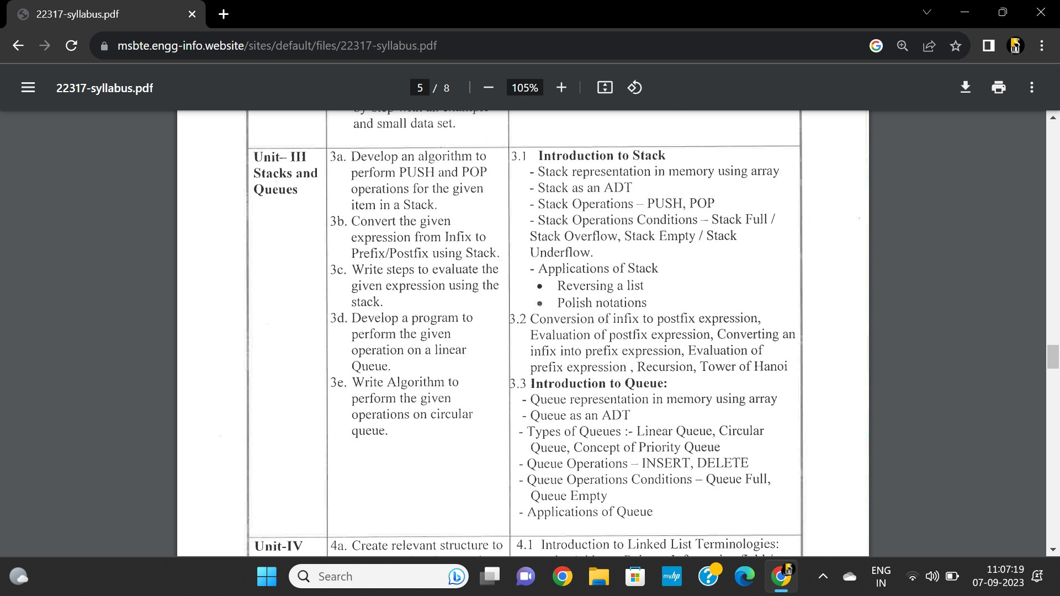

Slide 3
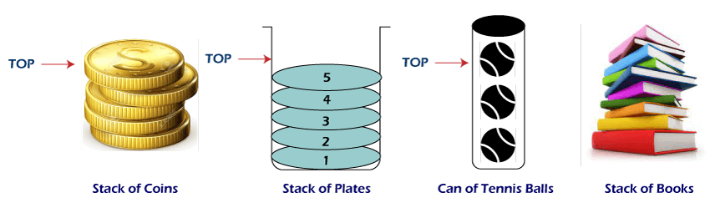
STACKS
-stack representation in memory using array
Stack as abstract datatype
Operations – push , pop
Conditions on stack operations
Application of stack

Slide 4
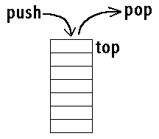
What is Stack?
Stack is a linear data structure in which the insertion and deletion operations are performed at only one end.
In a stack, adding and removing of elements are performed at a single position which is known as "top".
That means, a new element is added at top of the stack and an element is removed from the top of the stack.
In stack, the insertion and deletion operations are performed based on LIFO (Last In First Out) principle.
In the figure, PUSH and POP operations are performed at a top position in the stack. That means, both the insertion and deletion operations are performed at one end (i.e., at Top)

Slide 5
• It is type of linear data structure.
• It follows LIFO (Last In First Out) property.
• It has only one pointer TOP that points the last or top most element of Stack.
• Insertion and Deletion in stack can only be done from top only.
• Initially, the top is set to -1. Whenever we want to insert a value into the stack, increment the top value by one and then insert.
Whenever we want to delete a value from the stack, then delete the top value and decrement the top value by one.
• Insertion in stack is also known as a PUSH operation.
• Deletion from stack is also known as POP operation in stack.

Slide 6
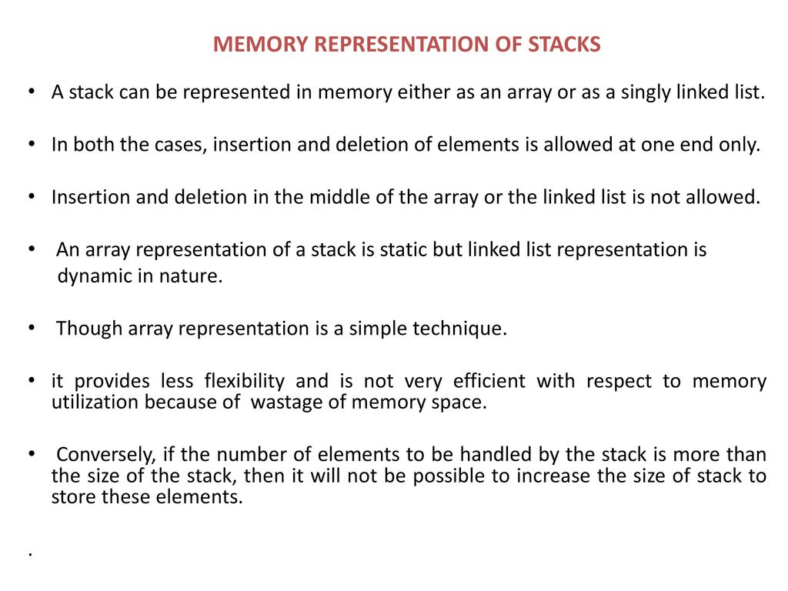

Slide 7
Memory Representation of Stacks
There are two ways to represent stacks in memory:
1. Array representation (Static data structure)
2. Linked list representation (Dynamic data structure)

Slide 8
Array representation of Stacks
A stack is a data structure that can be represented as an array.
Let us learn more about Array representation of a stack –An array is used to store an ordered list of elements. Using an array for representation of stack is one of the easy techniques to manage the data.
But there is a major difference between an array and a stack.
Size of an array is fixed.
While, in a stack, there is no fixed size since the size of stack changed with the number of elements inserted or deleted to and from it.
Despite the difference, an array can be used to represent a stack by taking an array of maximum size; big enough to manage a stack.

Slide 9
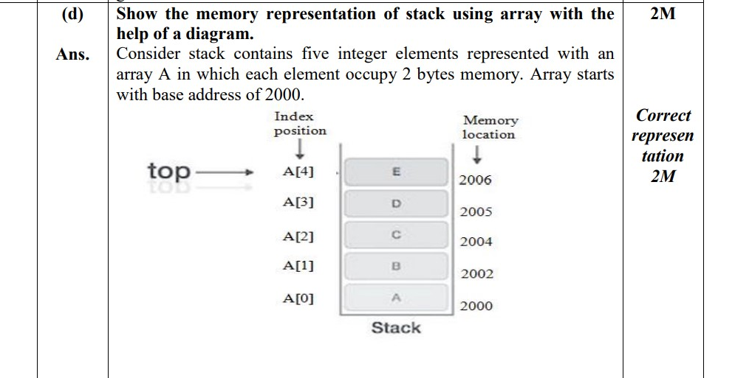

Slide 10
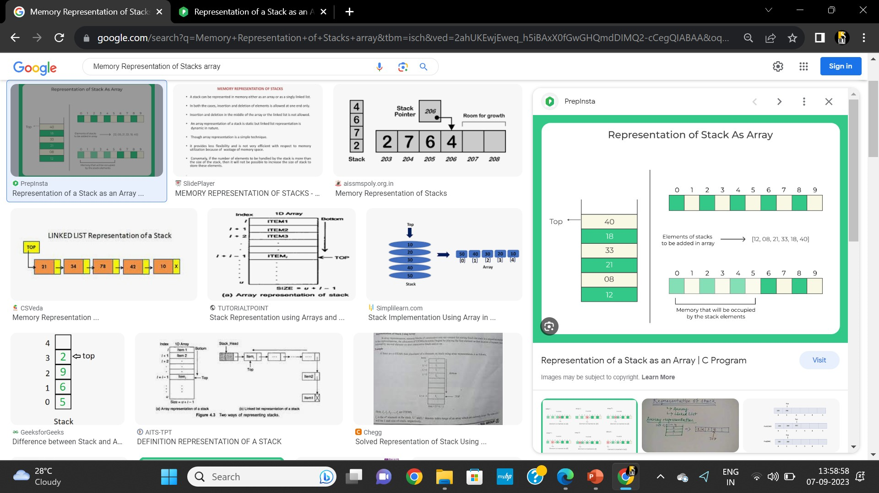
For Example:
We are given a stack of elements: 12 , 08 , 21 , 33 , 18 , 40.

Slide 11
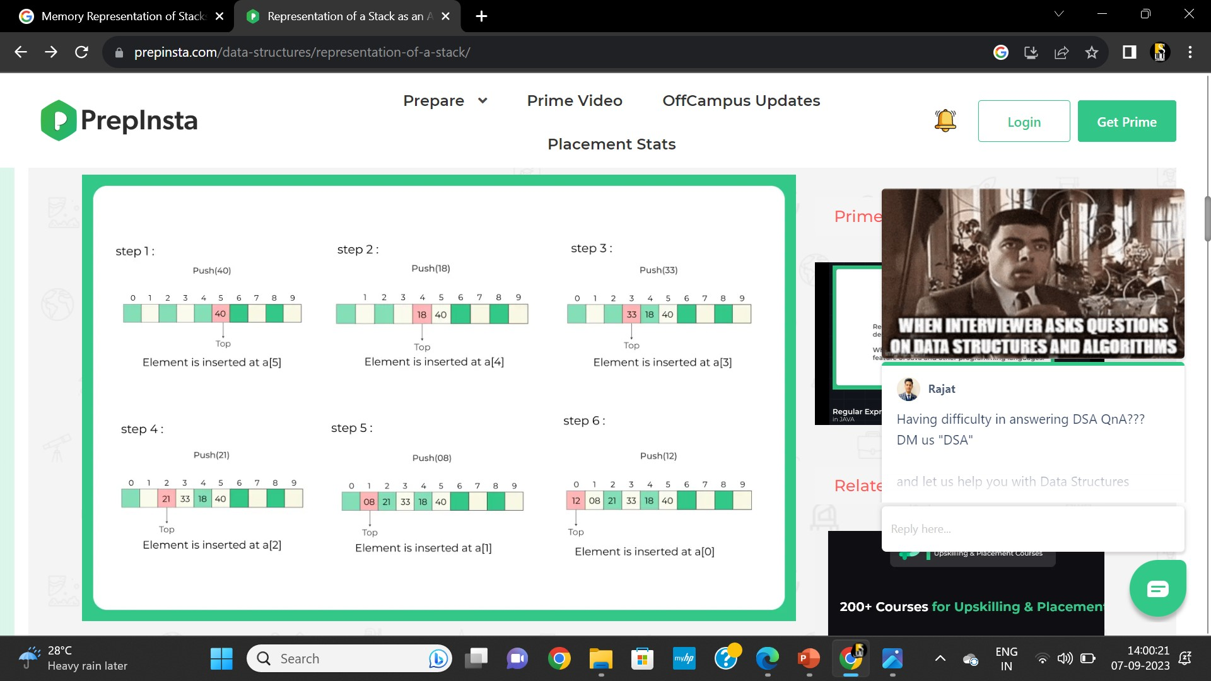

Slide 12
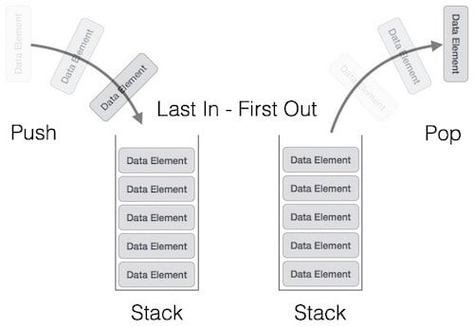
Operations on Stacks
PUSH
POP

Slide 13
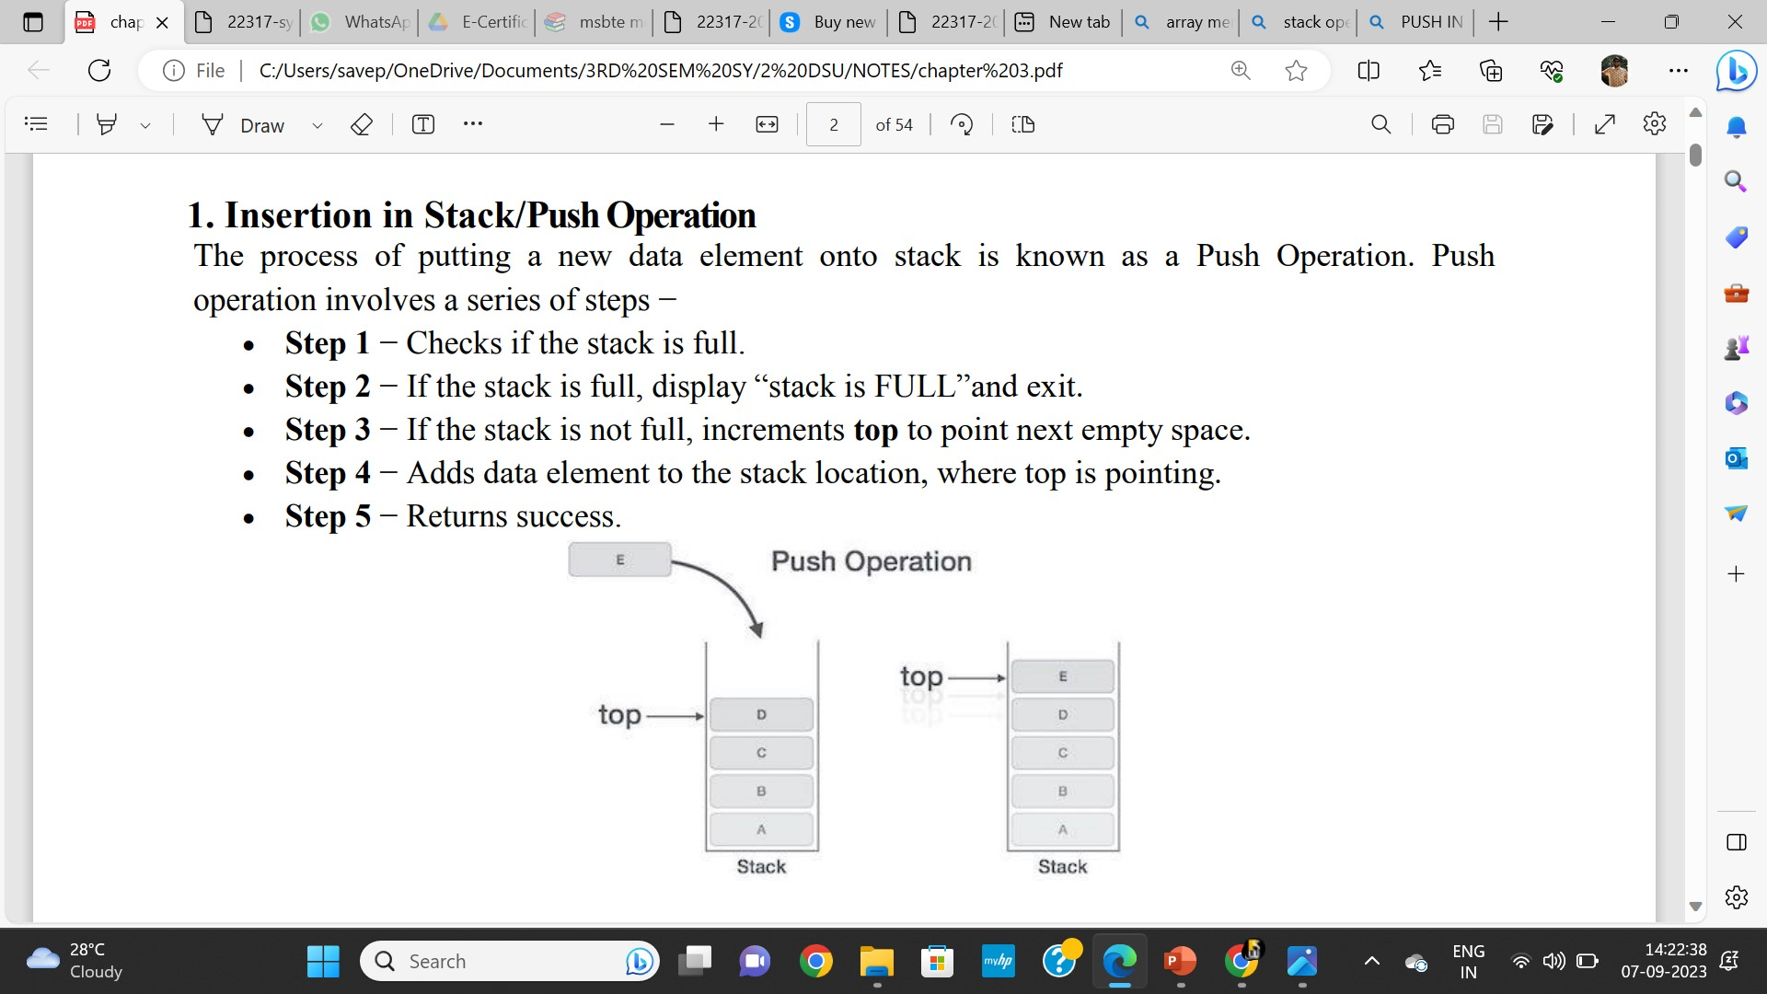
Insertion in Stack/Push Operation
This operation adds an element to the top of the stack.

Slide 14
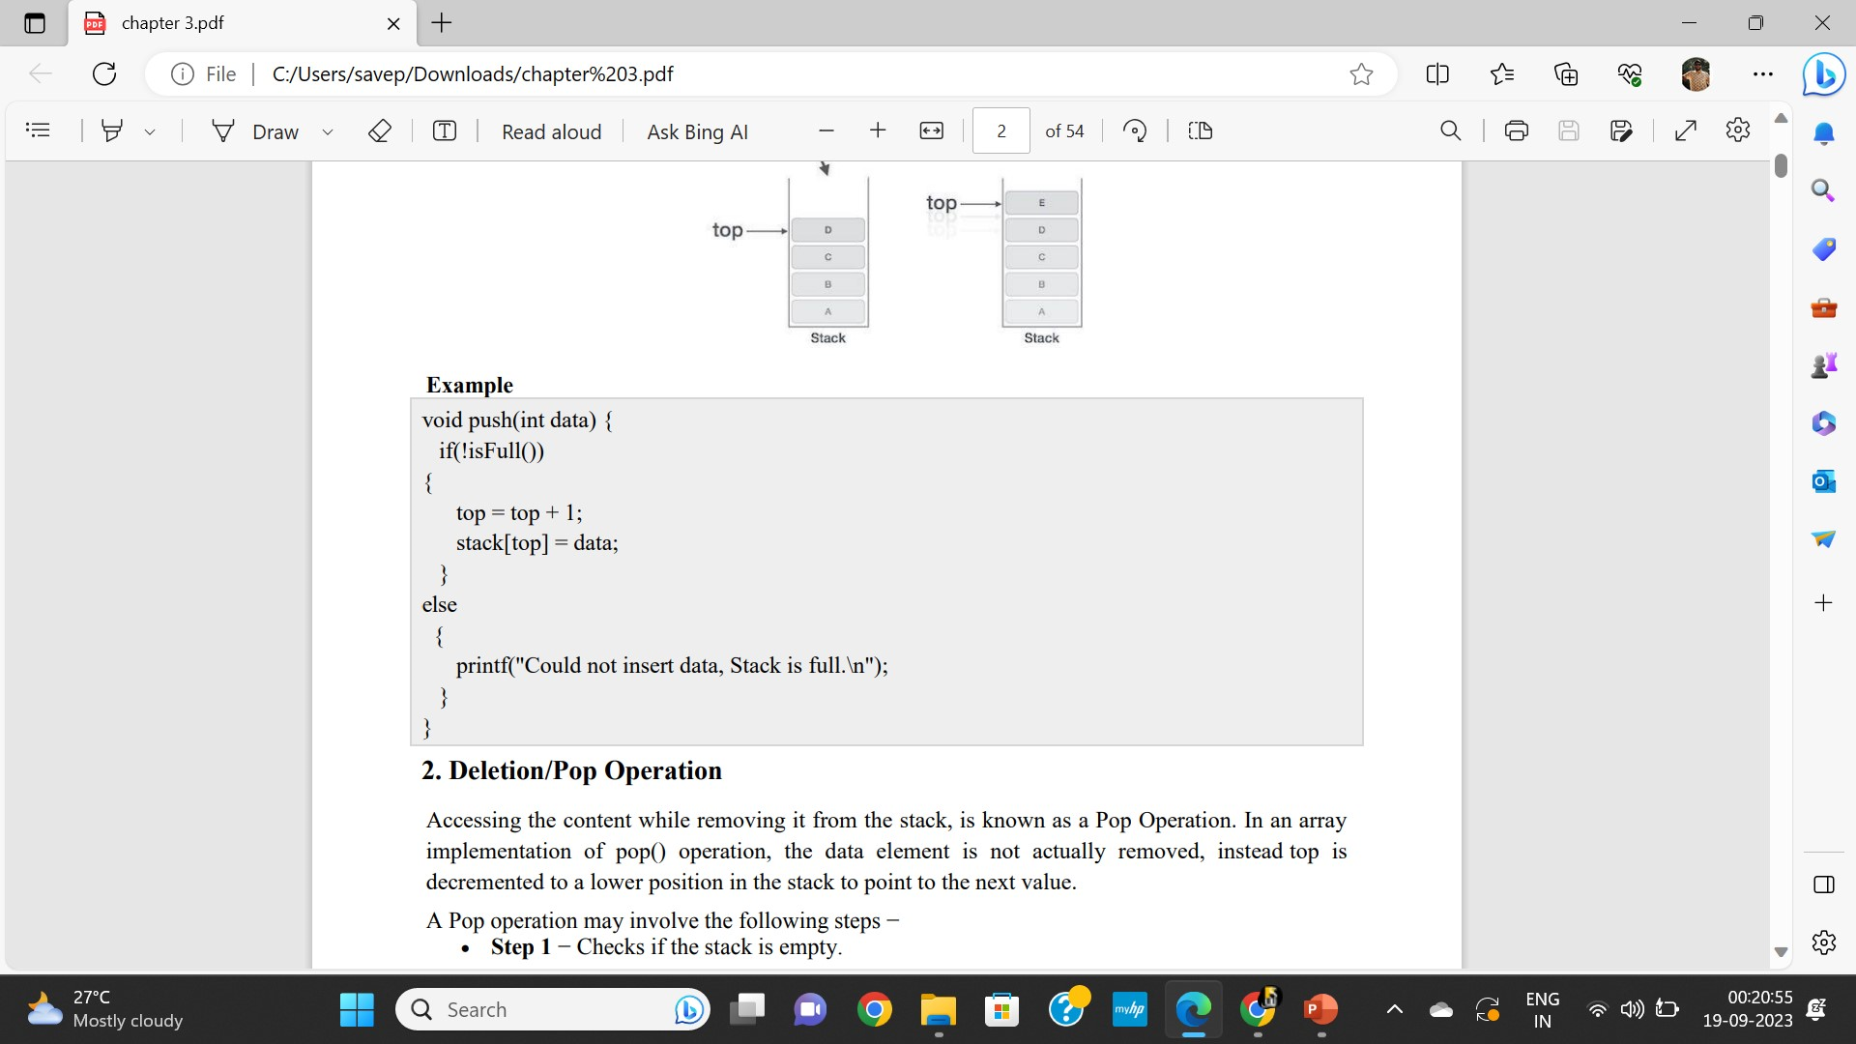

Slide 15
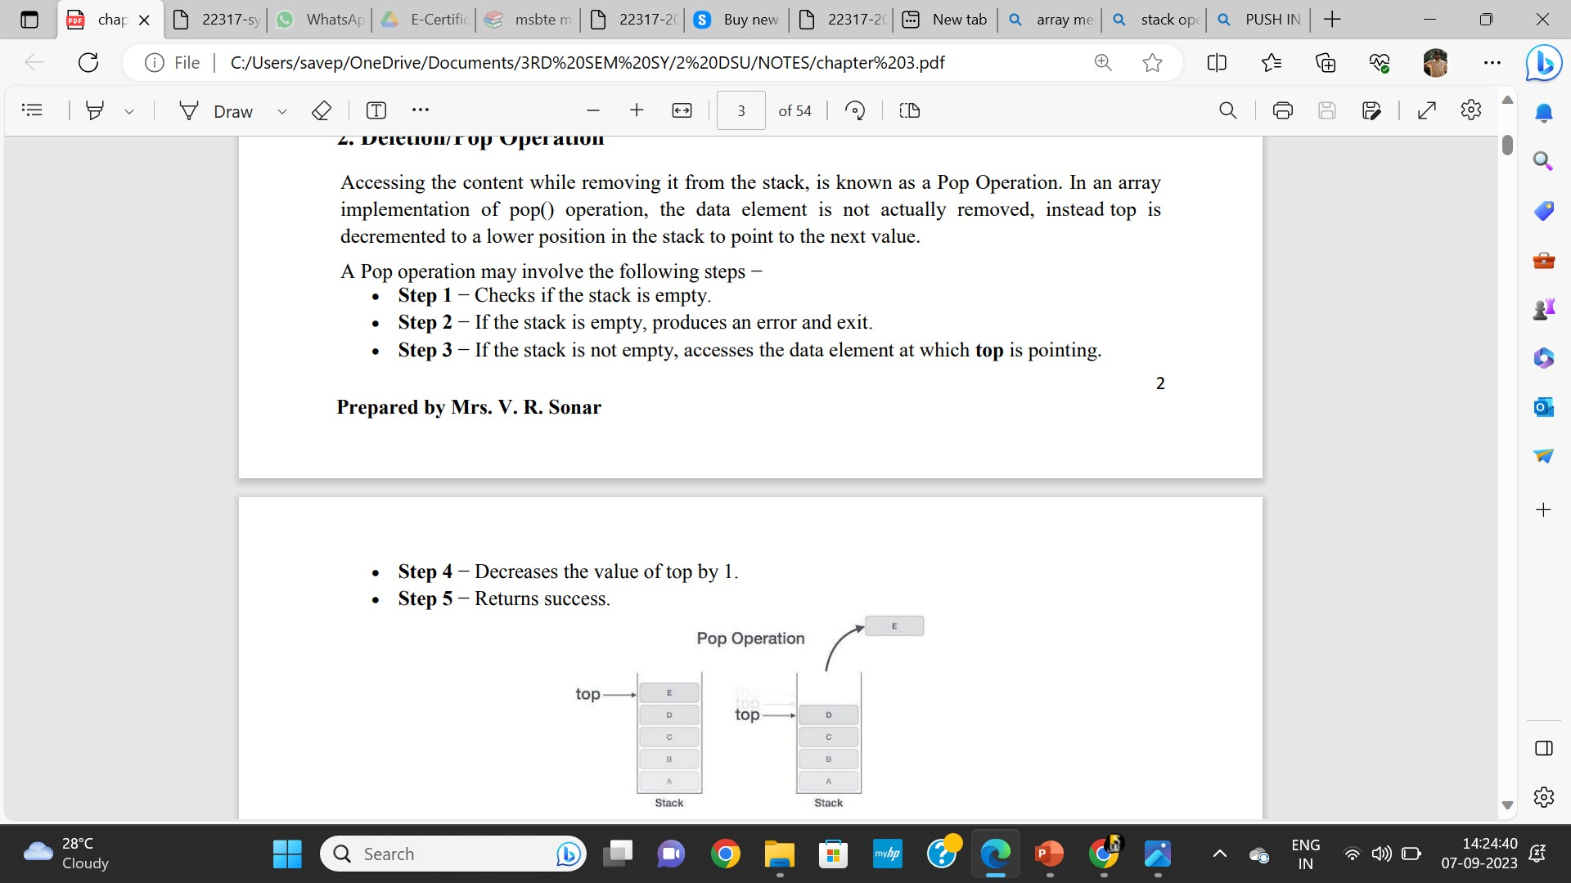
Deletion/Pop Operation
Removes and returns the top element from the stack.

Slide 16
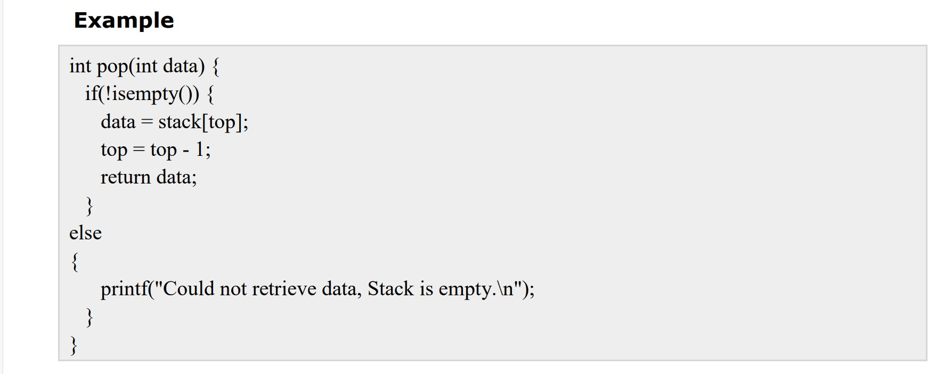

Slide 17
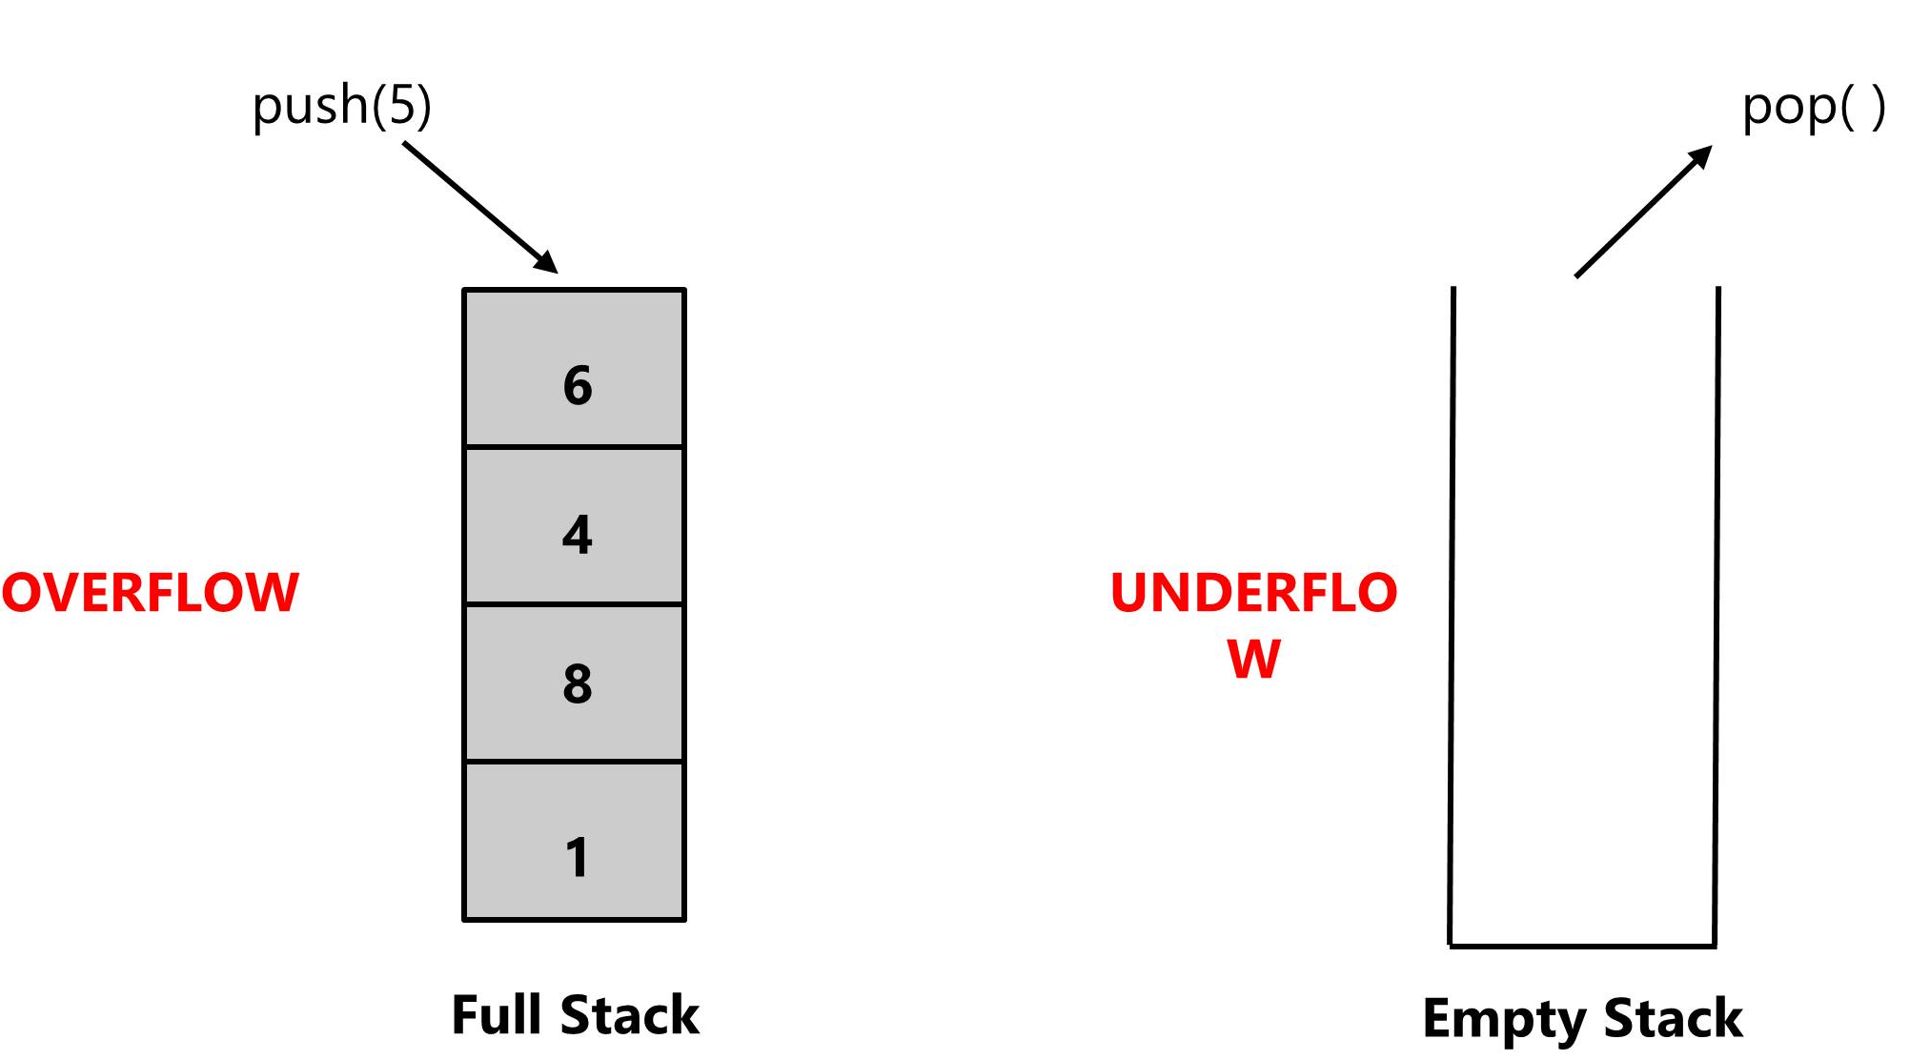
Stack Operation Conditions
STACK FULL / STACK OVERFLOW
STACK EMPTY / STACK UNDERFLOW

Slide 18
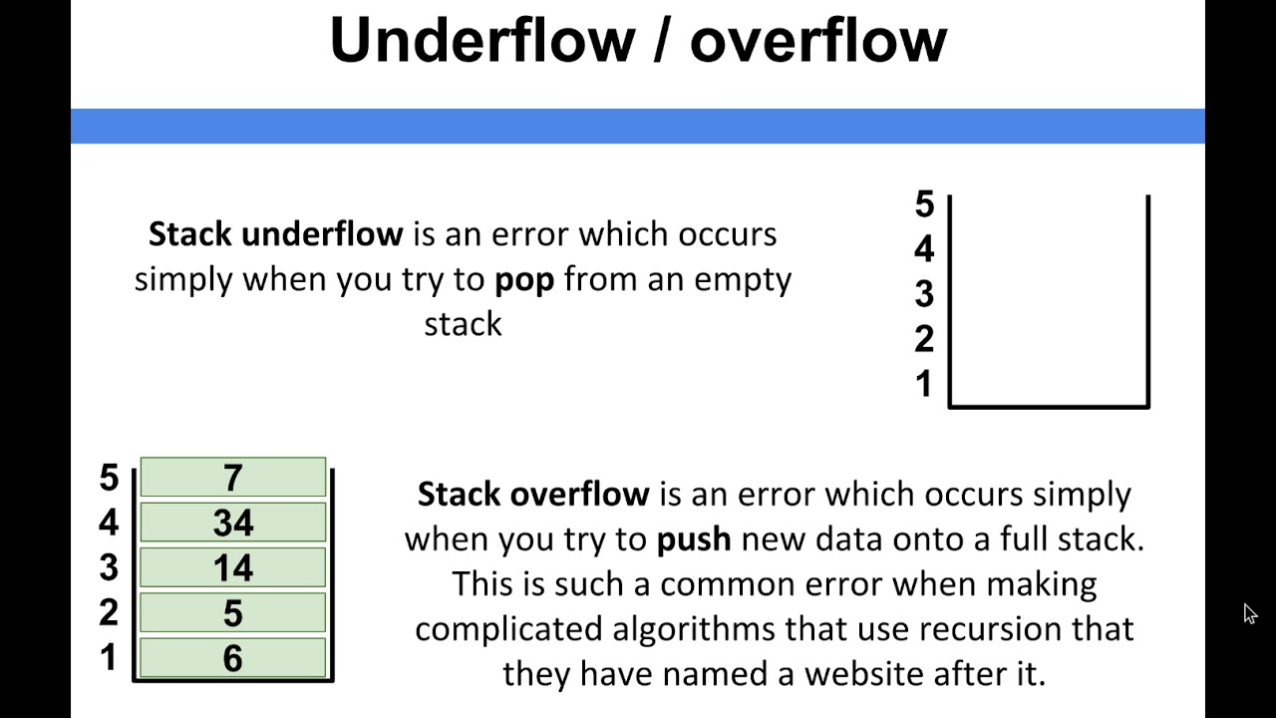

Slide 19
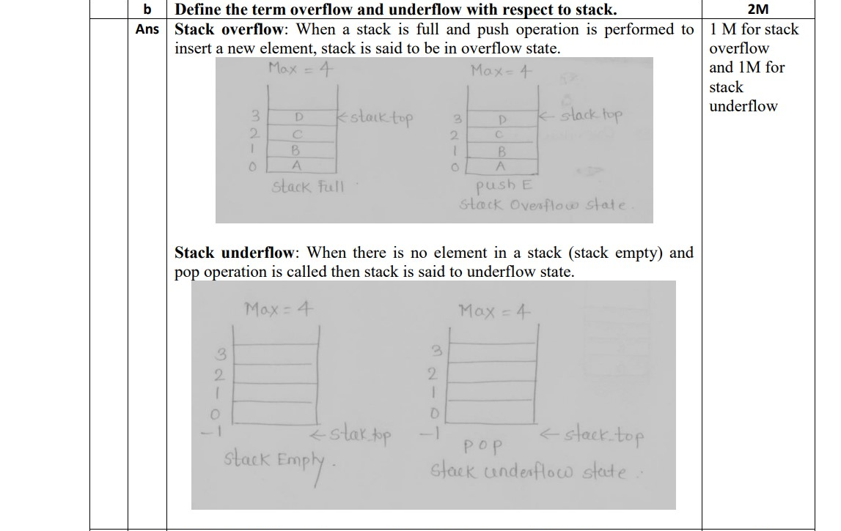

Slide 20
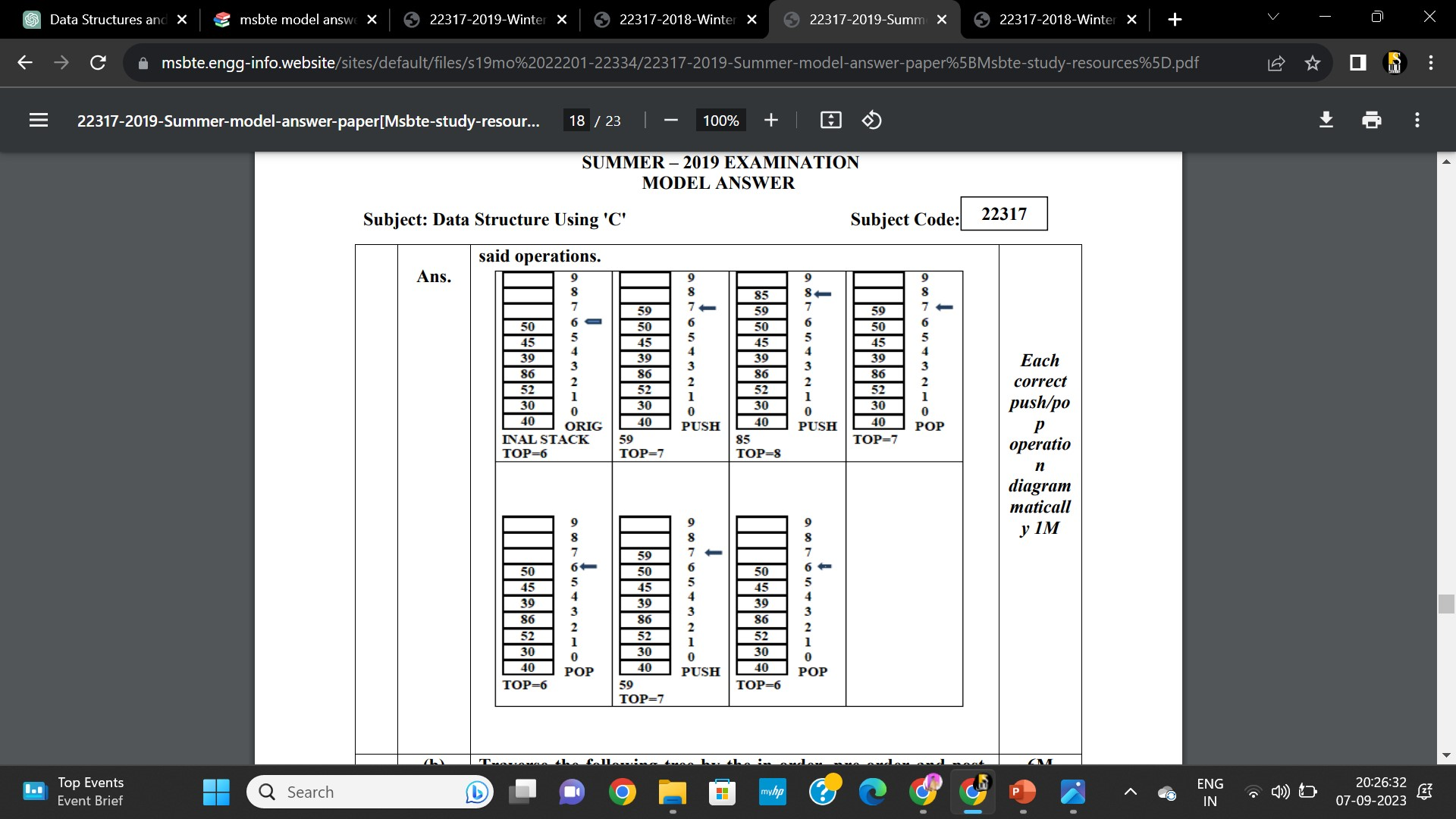
Show the effect of PUSH and POP operation on to the stack of size 10. The stack contains 40, 30, 52, 86, 39, 45, 50 with 50 being at top of the stack. Show diagrammatically the effect of:
(i) PUSH 59 (ii) PUSH 85 (iii) POP (iv) POP (v) PUSH 59 (vi) POP Sketch the final structure of stack after performing the above.

Slide 21
Stack as an ADT (Abstract Data Type):
Stack ADT Implementation instead of data being stored in each node, the pointer to data is stored.
The program allocates memory for the data and address is passed to the stack ADT.
The head node and the data nodes are encapsulated in the ADT.
The calling function can only see the pointer to the stack.
Discusses the concept of a stack as an abstract data type, which means that it defines a set of operations without specifying how these operations are implemented.

Slide 22
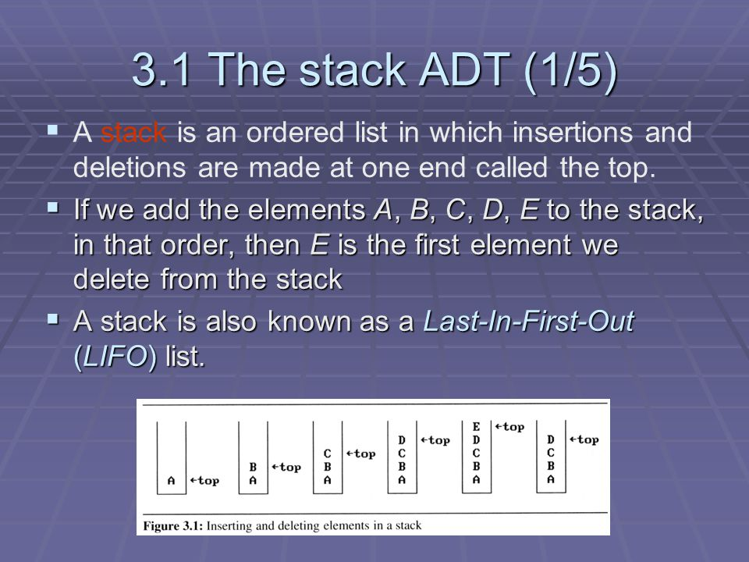

Slide 23
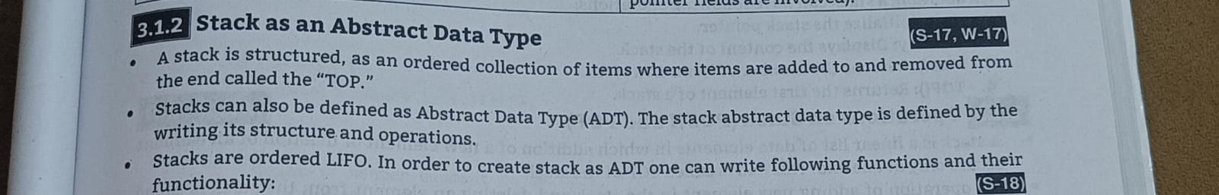

Slide 24
Stack (ADT) Data Structure:
Stack is an Abstract data structure (ADT) works on the principle Last In First Out (LIFO).
The last element add to the stack is the first element to be delete.
Insertion and deletion can be takes place at one end called TOP.
It looks like one side closed tube.
• The add operation of the stack is called push operation
• The delete operation is called as pop operation.
• Push operation on a full stack causes stack overflow.
• Pop operation on an empty stack causes stack underflow.
• SP is a pointer, which is used to access the top element of the stack.
• If you push elements that are added at the top of the stack;
• In the same way when we pop the elements, the element at the top of the stack is deleted

Slide 25

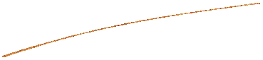
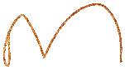
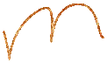
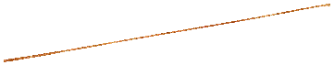
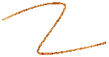
Applications of Stacks
Stacks are used where the LIFO principle is required like reversing strings, checking whether the arithmetic expression is properly parenthesized, converting infix notation to postfix and prefix notations, evaluating postfix expressions, implementing recursion and function calls, etc.
Various applications of stacks are listed below and this section discusses some of these applications :
Reversing a string
Polish notations.
Conversion of Infix to postfix expression.
Evaluation of postfix expression.
Conversion of Infix to prefix expression.
Evaluation of prefix expression
Recursion.
Backtracking (game playing, finding paths, exhaustive searching).
Stacks are widely used in operating systems, by compiler and by applications. Some of the applications are:
Subroutine calls
2. Interrupt handling.
3. Matching parentheses in an expression.

Slide 26
Applications of Stack
Reversing a list: You can use a stack to reverse the order of elements in a list efficiently.
Polish notations: Stacks are used to evaluate expressions in postfix (Reverse Polish) notation

Slide 27
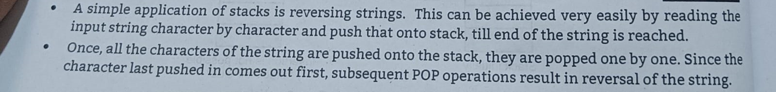
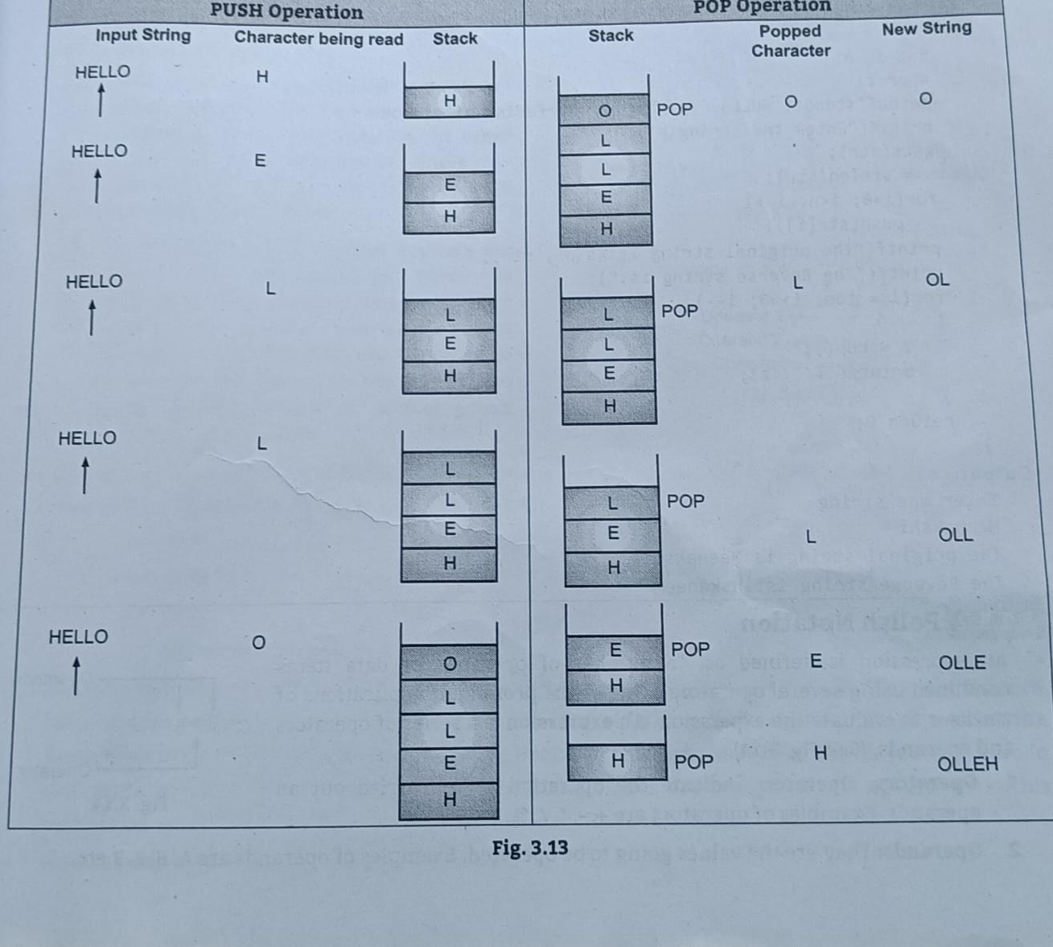
Reversing a list

Slide 28
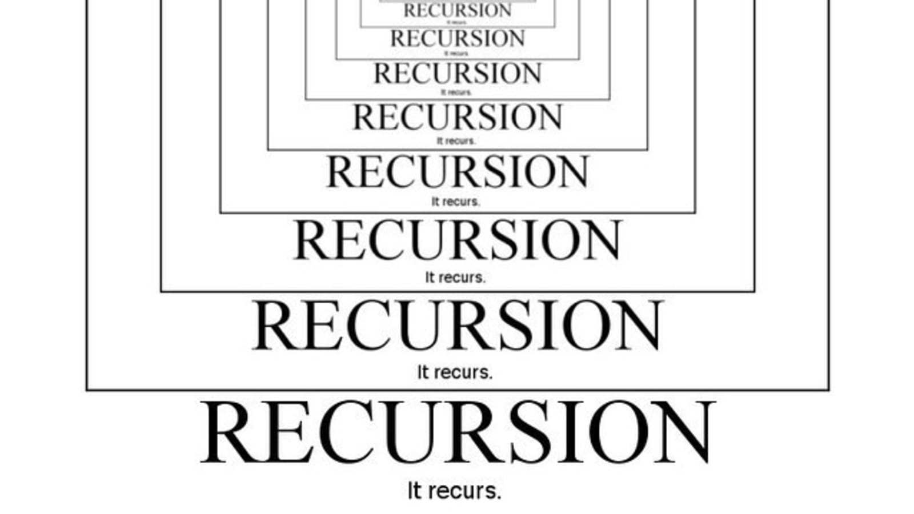
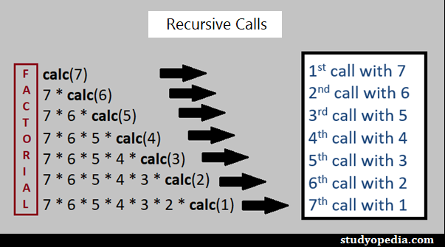
Recursion (6marks)
Recursion is a process of calling a function by itself. a recursive function body contains a function call statement that calls itself repetitively. Recursion is an application of stack. When a recursive function calls itself from body, stack is used to store temporary data handled by the function in every iteration.

Slide 29
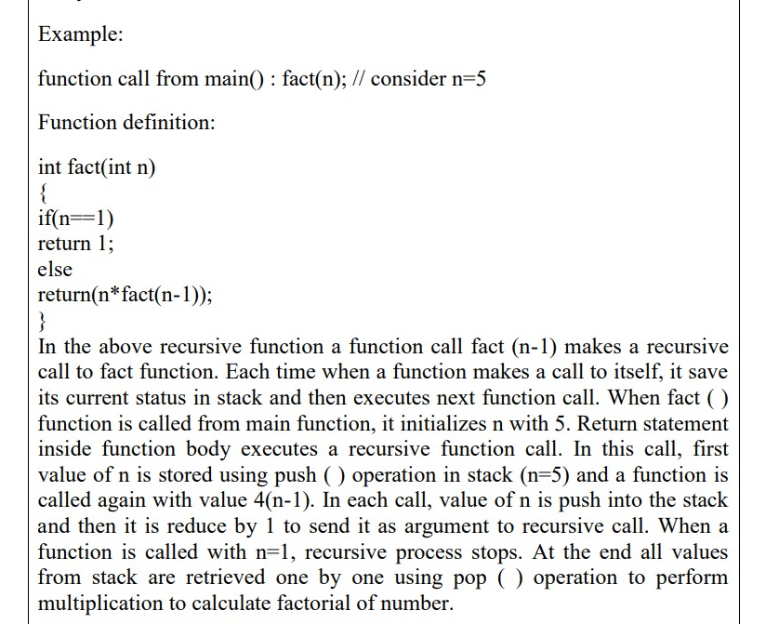

Slide 30
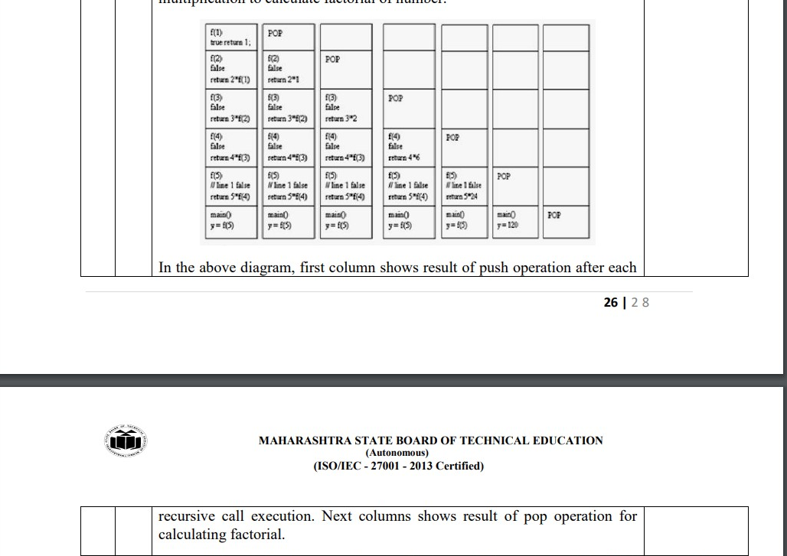

Slide 31
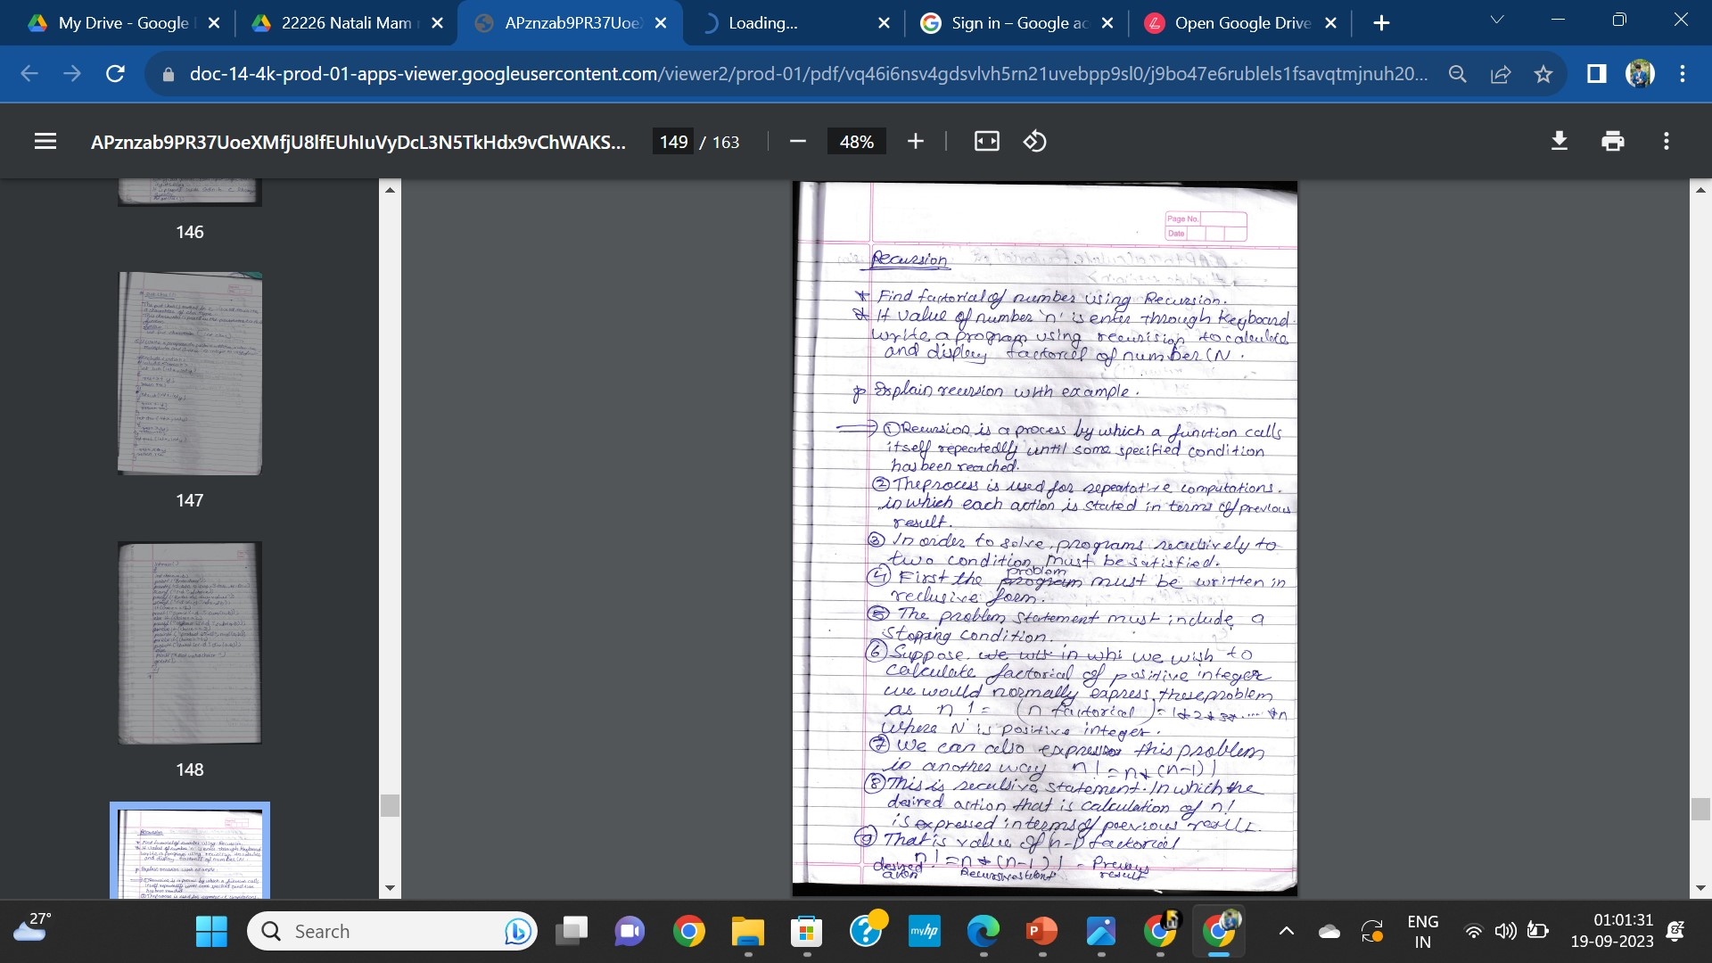
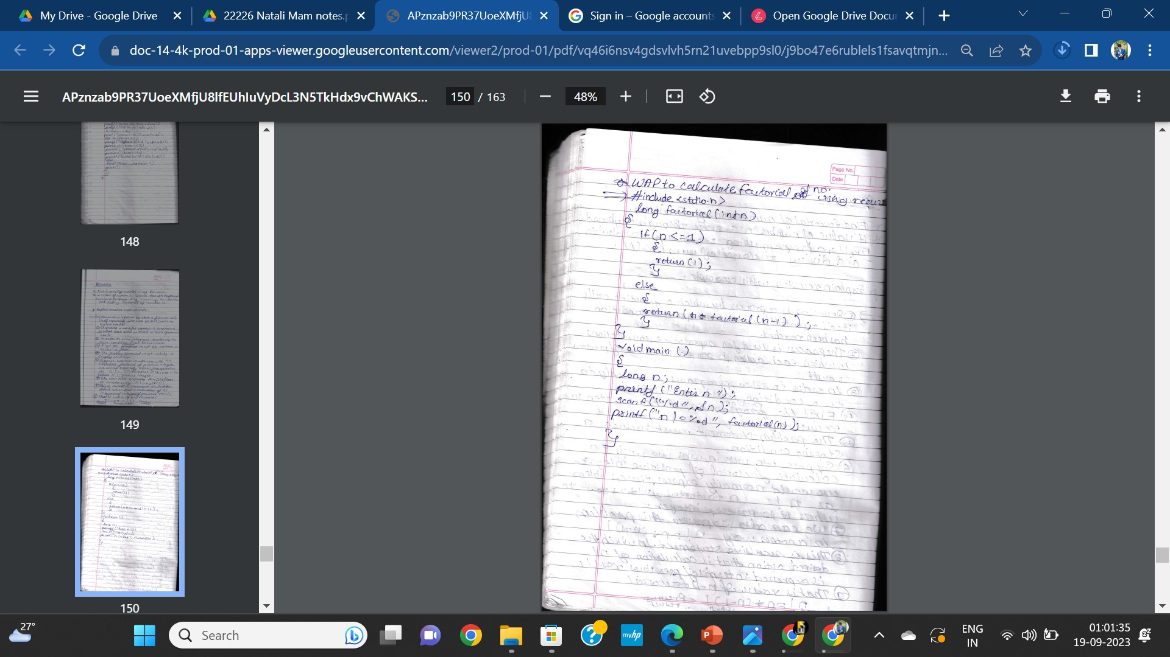

Slide 32
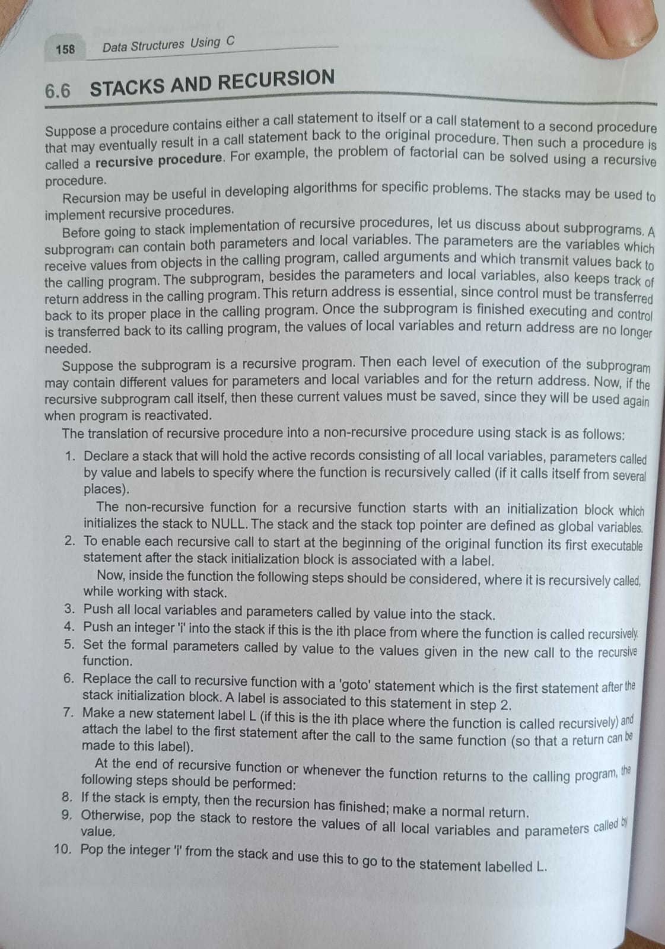

Slide 33
Basics…….
Operators
Result=A+B
Operation
Operands

Slide 34
Polish Notations
The process of writing the operators of an expression either before their operands or after them is called polish notation.
The This notation was introduced by Jan Lukasiwicz .
The main property of polish notations is that the order in which operations are to be performed is ascertained by the position of the operators and operands in the expression.
The way to write arithmatic expression is known as notation. The process of placing the operator at a particular place in an expression is called polish notation.
The computer system can understand and work only on binary paradigm. It assumes that an arithematic operation can take place between two operands only.
For example, A+B , C x D , D/A
Usually an arithematic expression may consist of more than one operator and two operands .for example, (A+B)Xc(D/(J+D)).
These complex arithmetic expressions can be converted into polish strings using stacks which can then be exceuted in two operands and operands form.

Slide 35
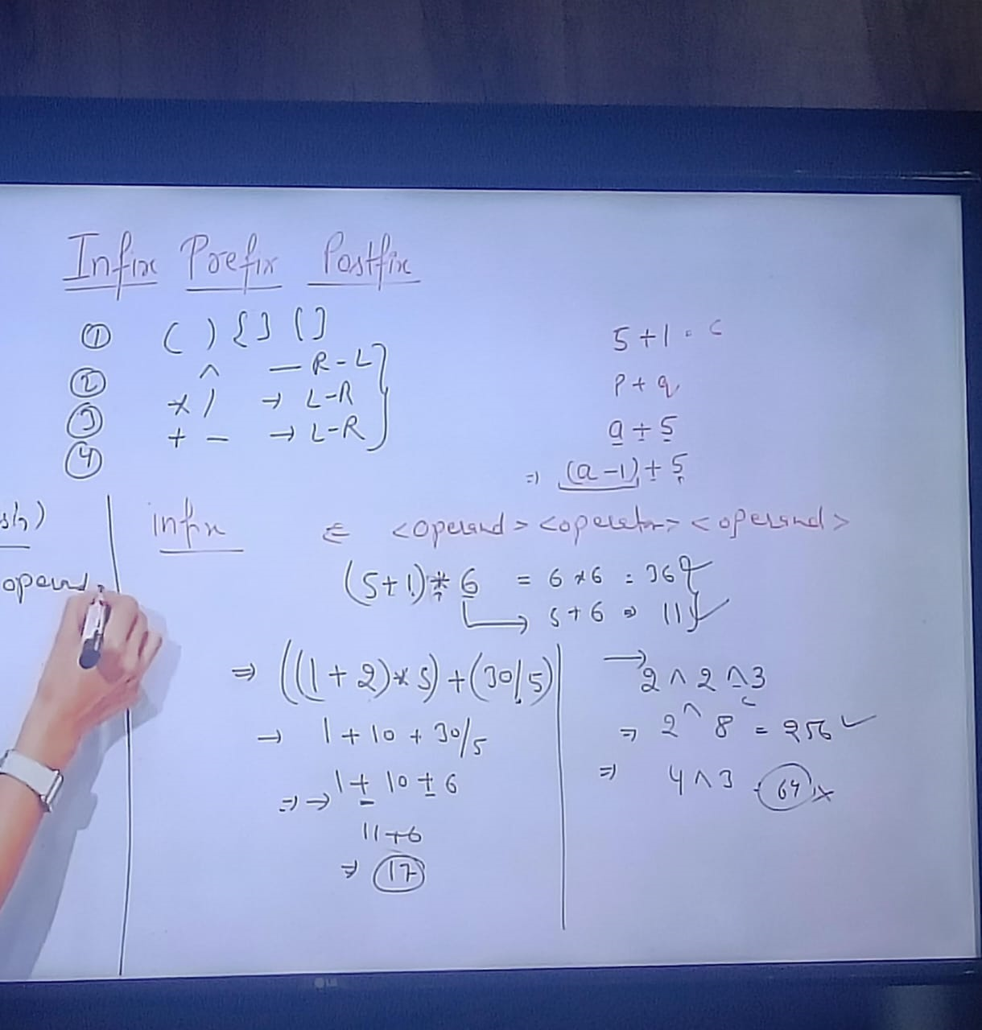

Slide 36
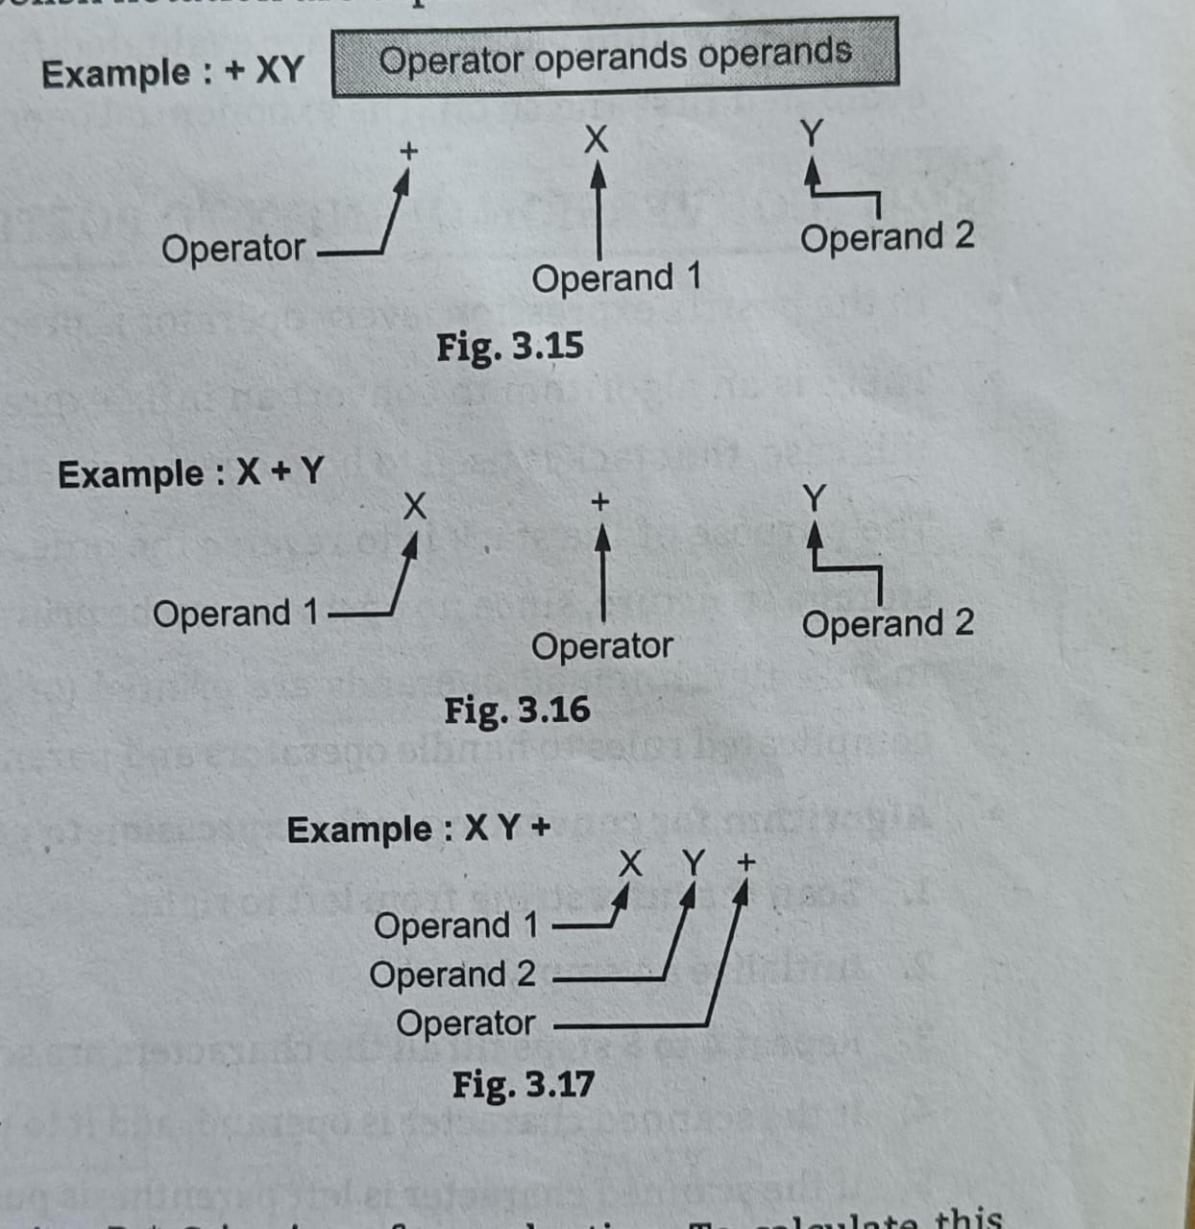
If the operator symbols are placed before the operands , then the expressions is in prefix notations.
If the operator symbols are placed between the operands , then the expressions is in prefix notations.
If the operator symbols are placed after the operands , then the expressions is in prefix notations

Slide 37
Evaluation of Postfix Expression using Stack:
to evaluate a postfix expression we can use a stack.
Iterate the expression from left to right and keep on storing the operands into a stack. Once an operator is received, pop the two topmost elements and evaluate them and push the result in the stack again.
Follow the steps mentioned below to evaluate postfix expression using stack:
Create a stack to store operands (or values).
Scan the given expression from left to right and do the following for every scanned element.
If the element is a number, push it into the stack.
If the element is an operator, pop operands for the operator from the stack. Evaluate the operator and push the result back to the stack.
When the expression is ended, the number in the stack is the final answer.

Slide 38
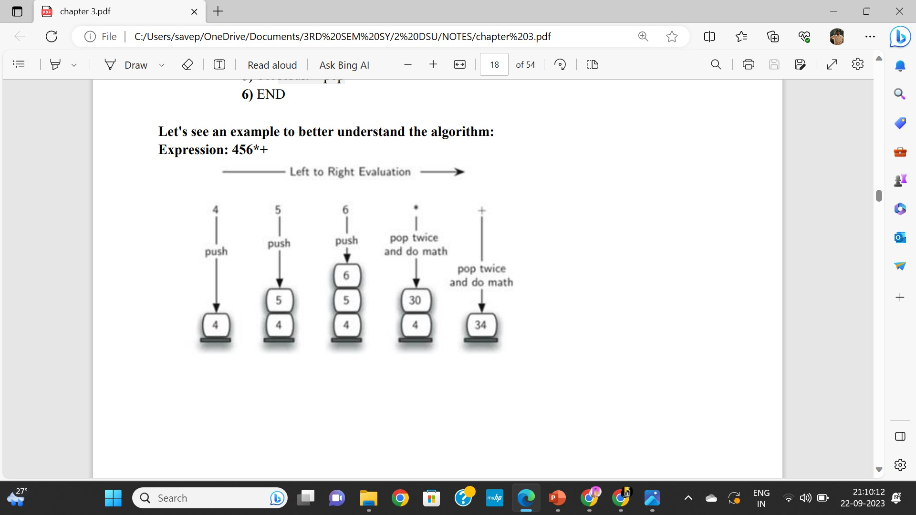
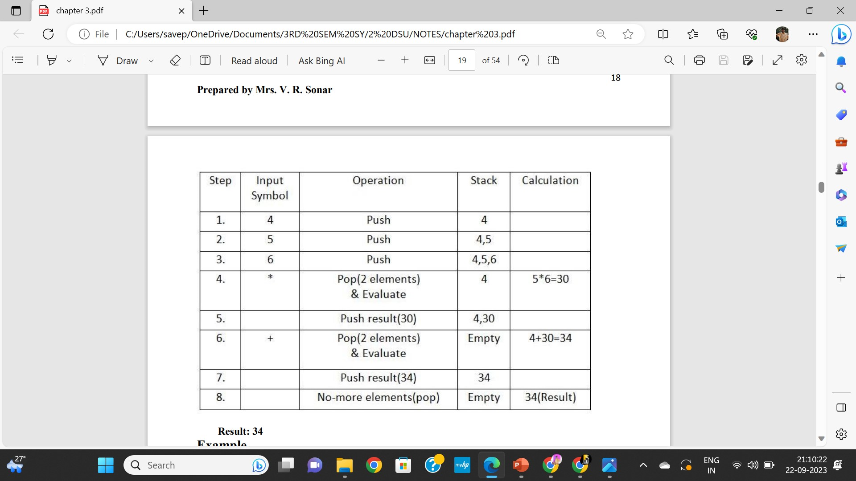

Slide 39
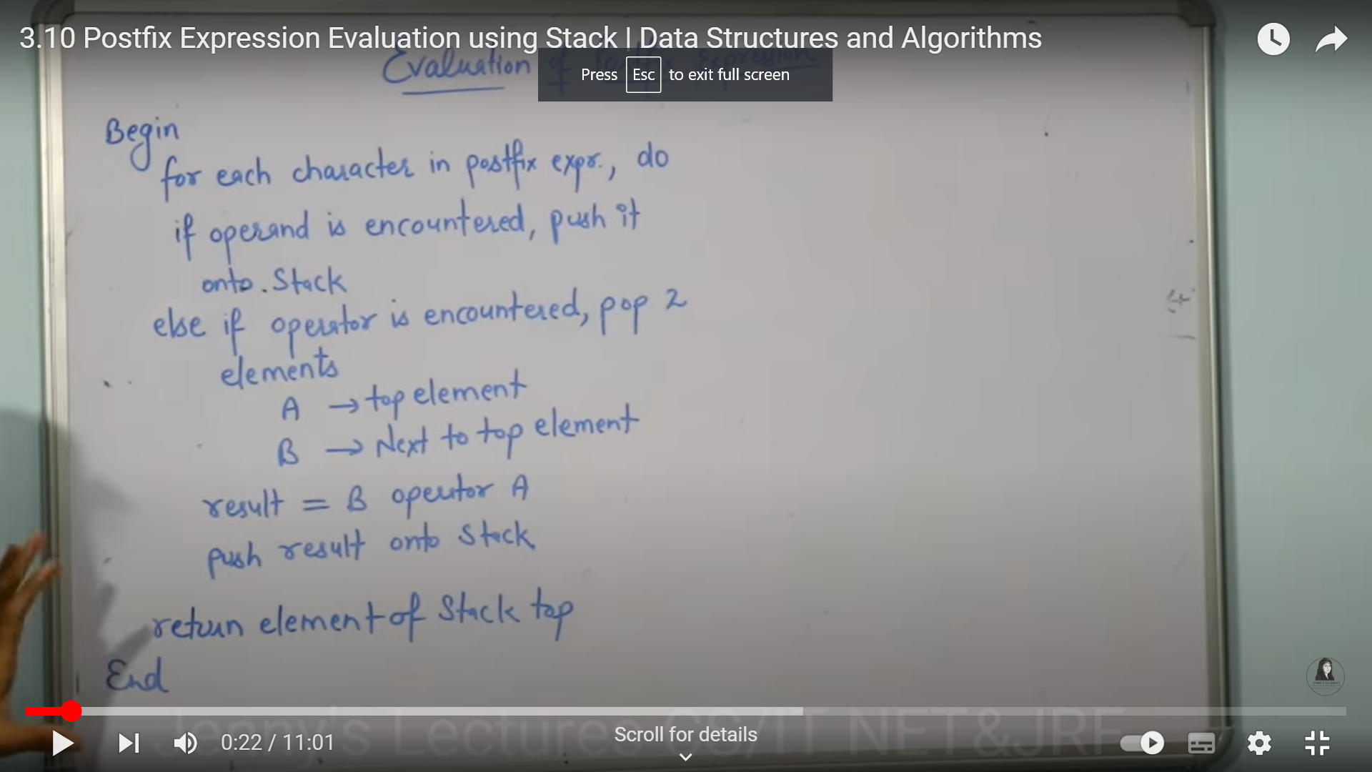

Slide 40
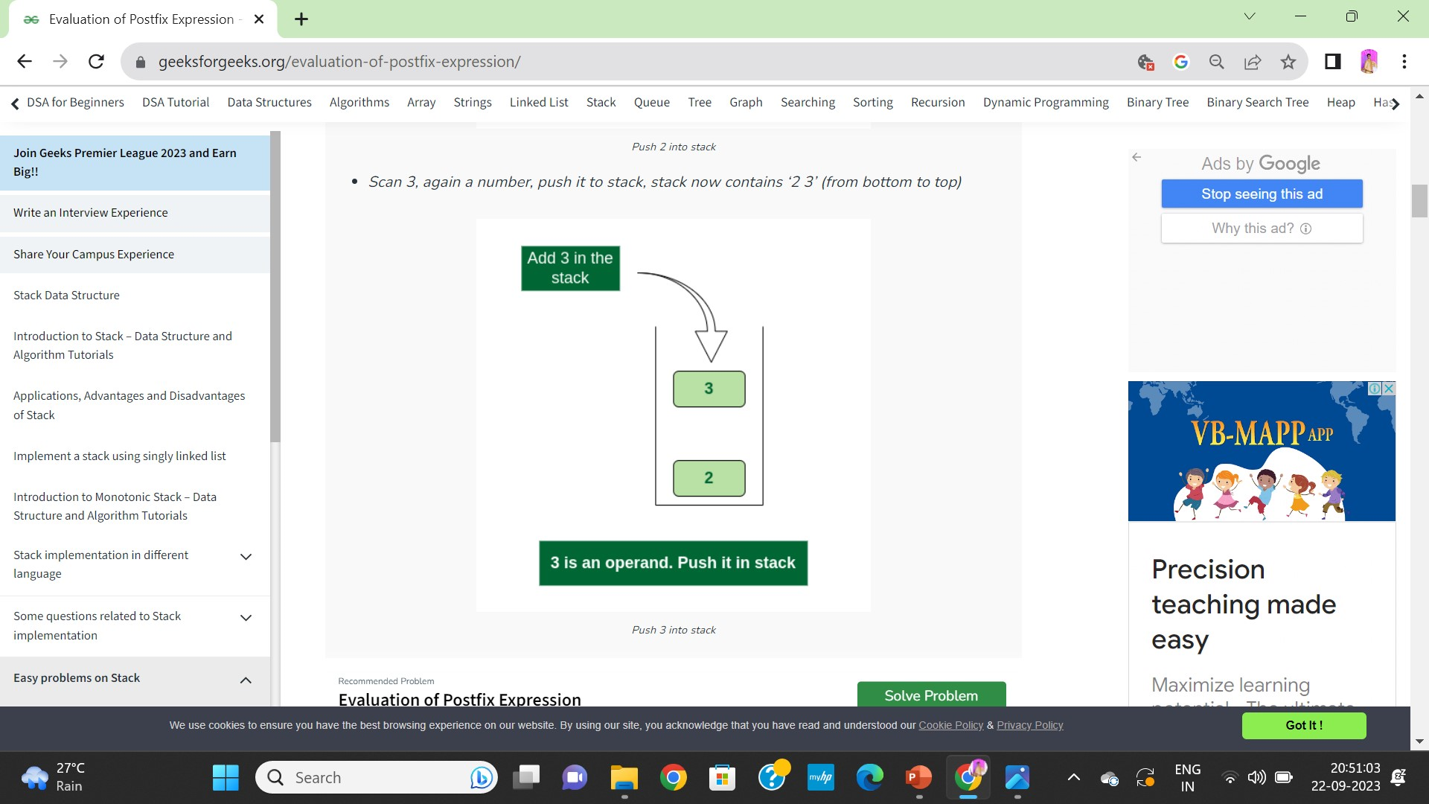
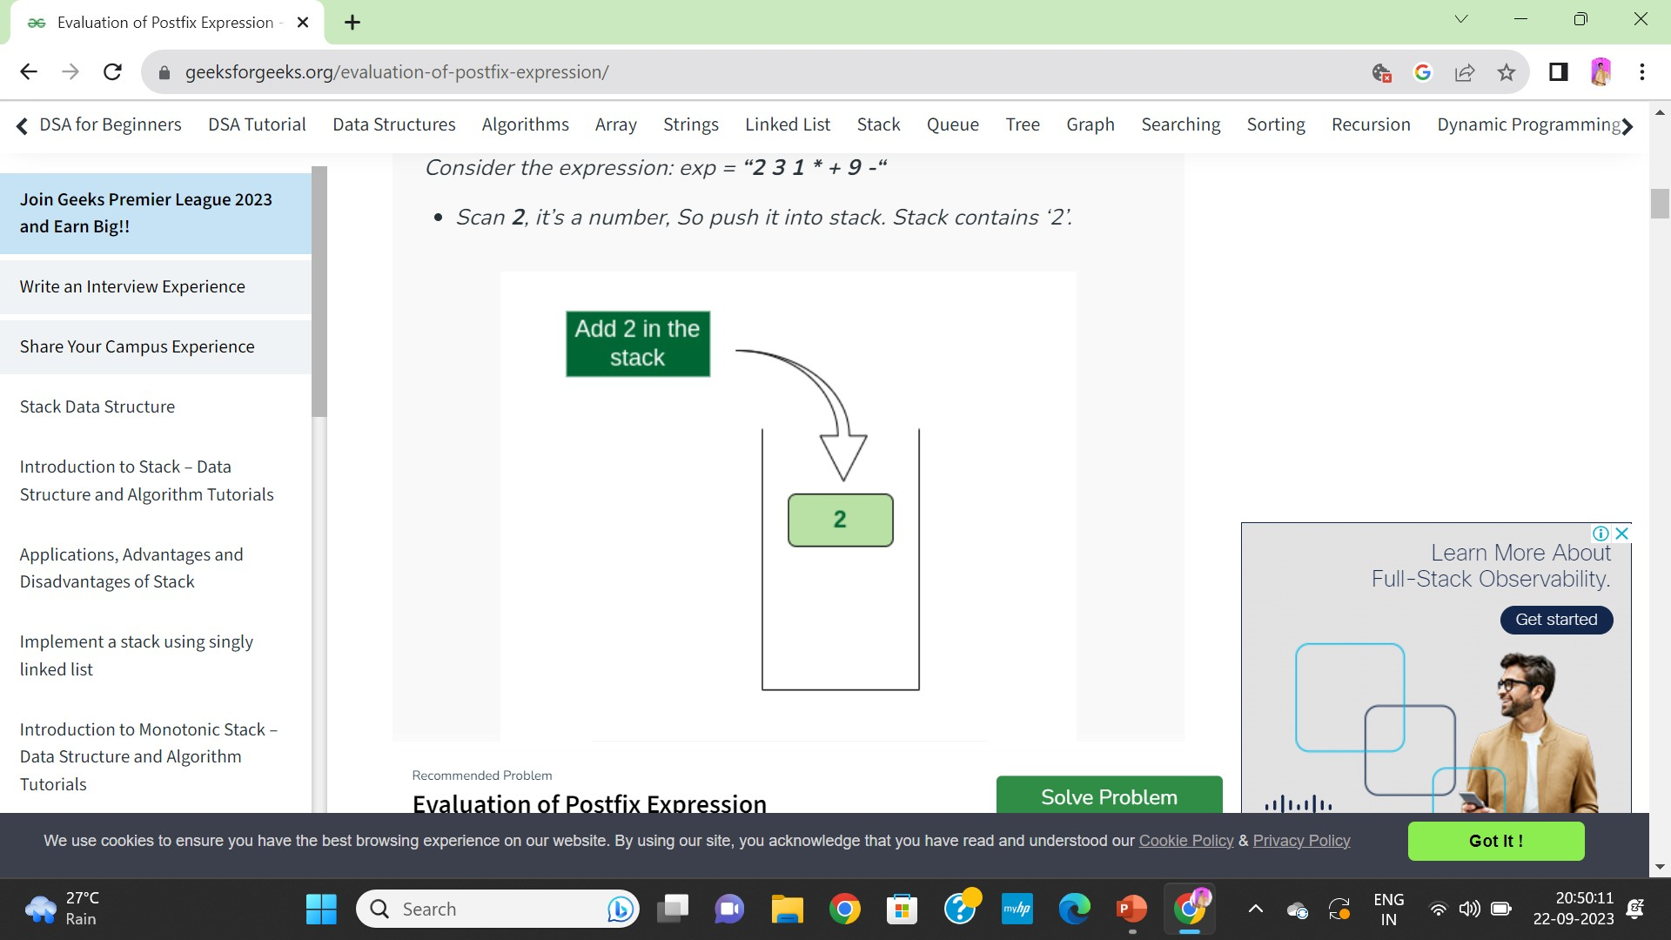
Consider the expression: exp = “2 3 1 * + 9 -“

Slide 41
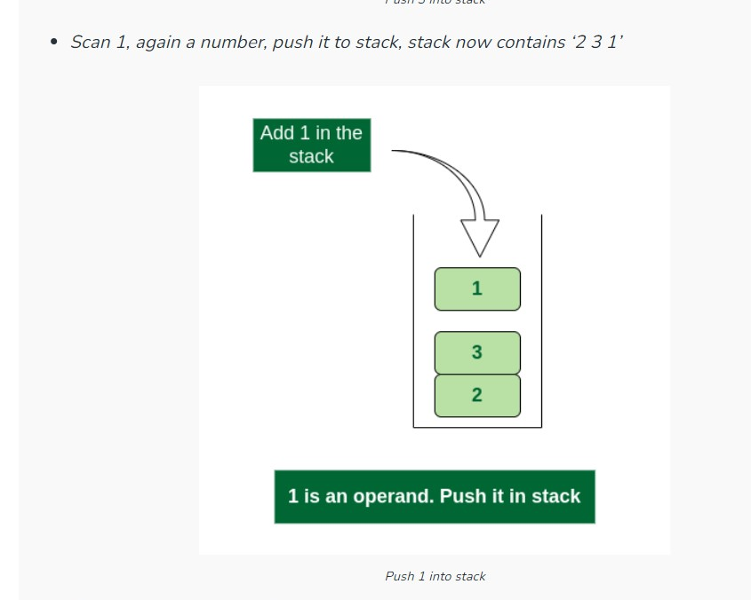

Slide 42
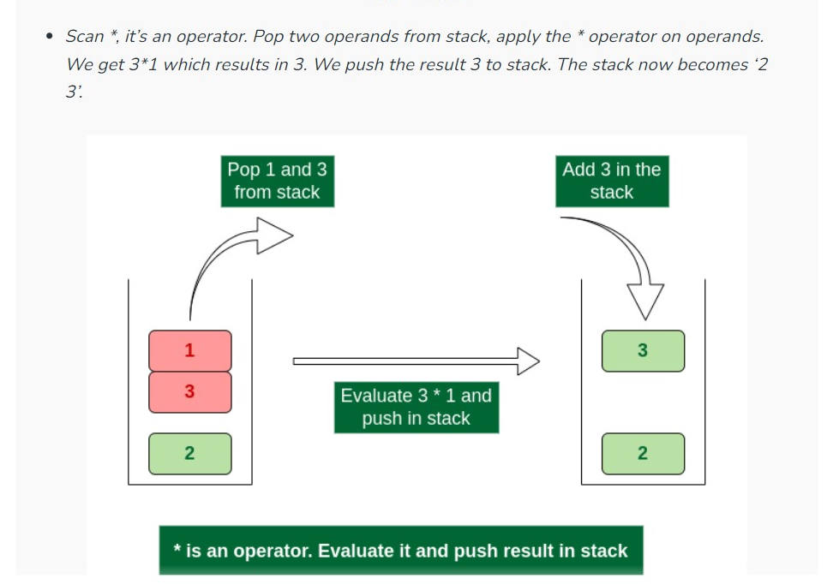

Slide 43
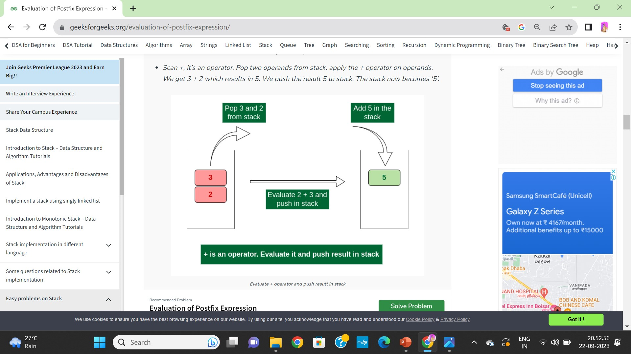
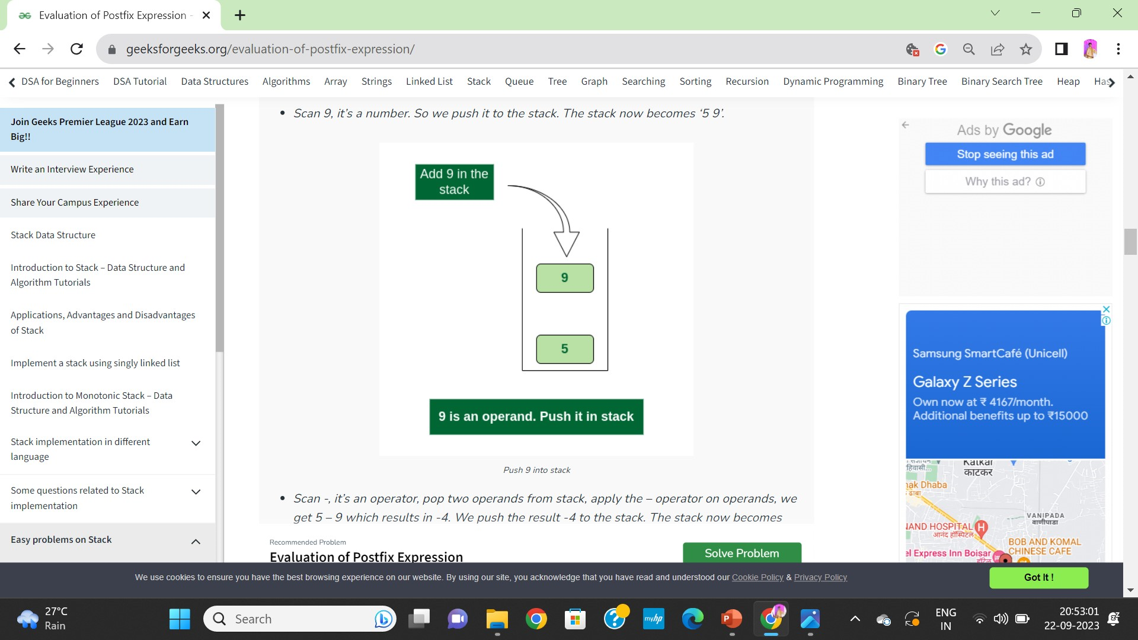

Slide 44
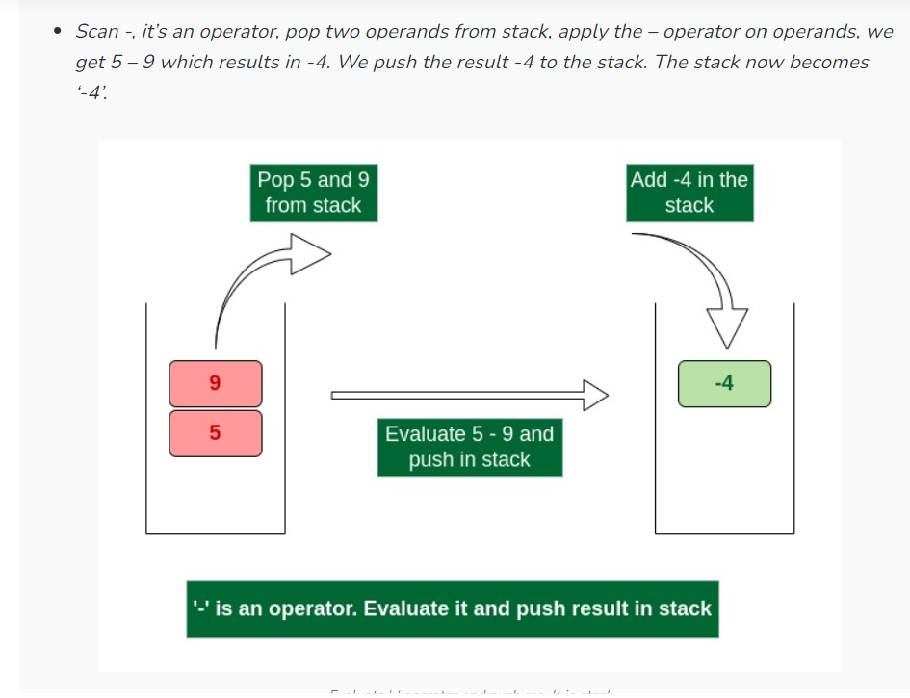
There are no more elements to scan, we return the top element from the stack (which is the only element left in a stack).
So the result becomes -4.

Slide 45
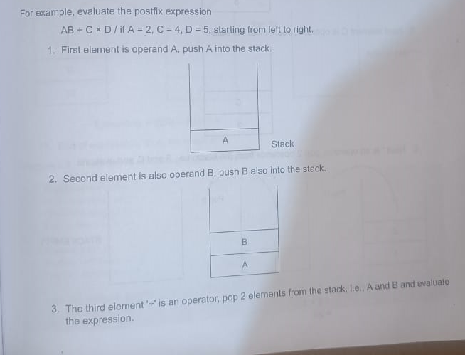

Slide 46
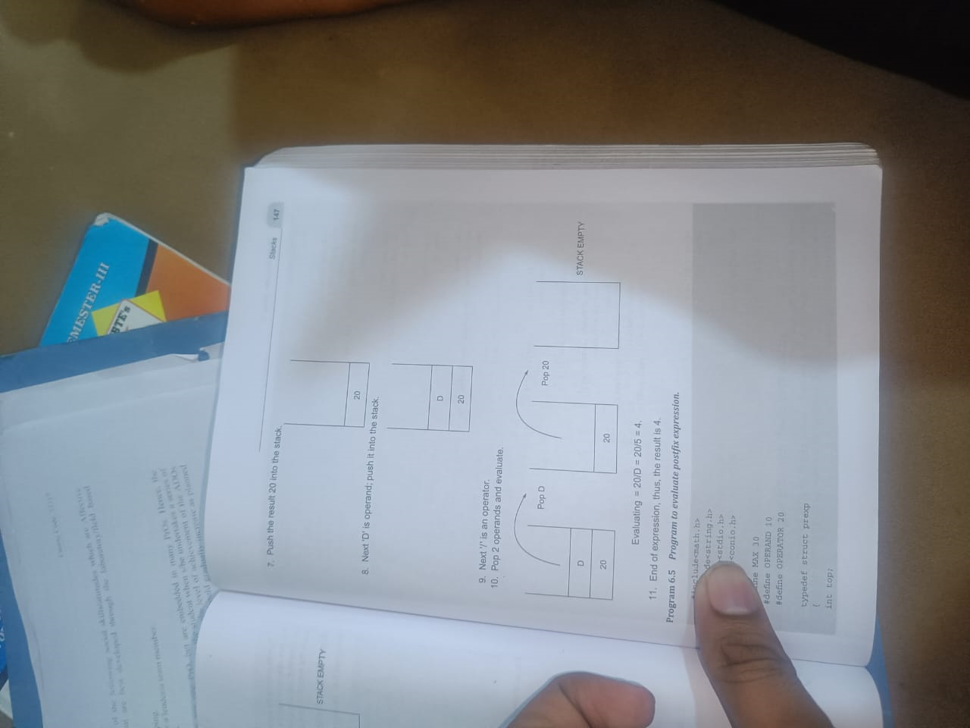
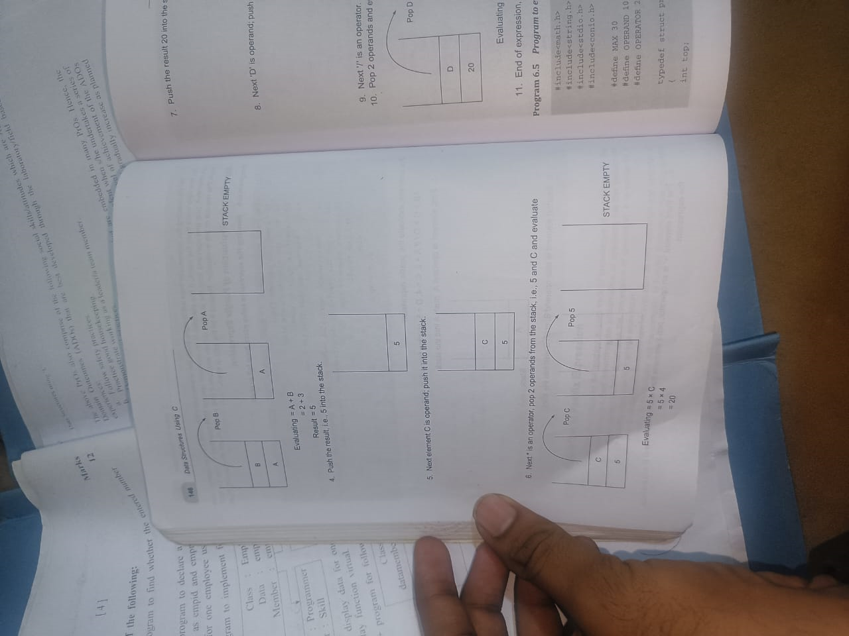

Slide 47
5 3 + 6 2 / x 3 5 x + 4 6 2 4 + * 6 3 / - 10 2 * 15 3 / + 12 3 + +
Solved it

Slide 48
Conversion Infix to Postfix expression
Infix expression: The expression of the form “a operator b” (a + b) i.e., when an operator is in-between every pair of operands.
Postfix expression: The expression of the form “a b operator” (ab+) i.e., When every pair of operands is followed by an operator.

Slide 49
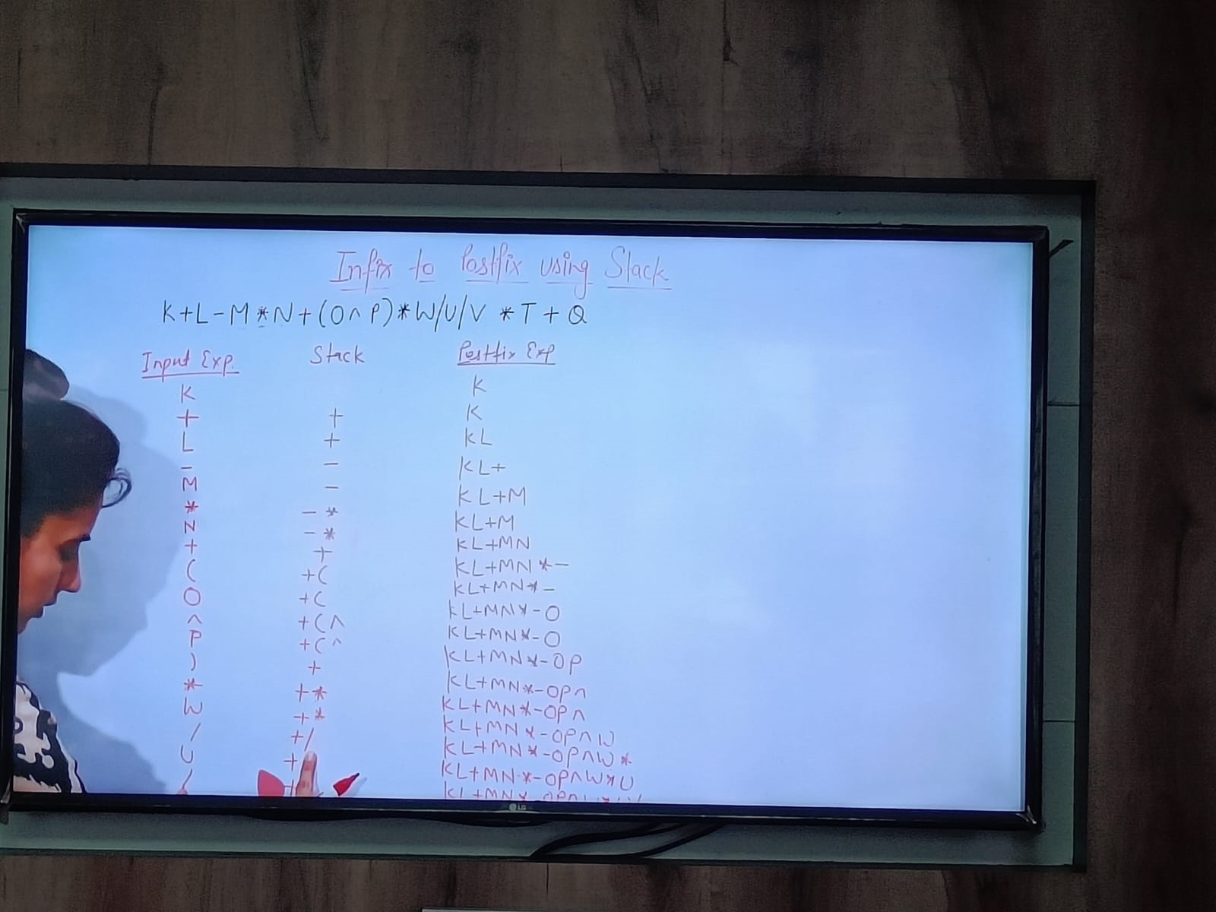
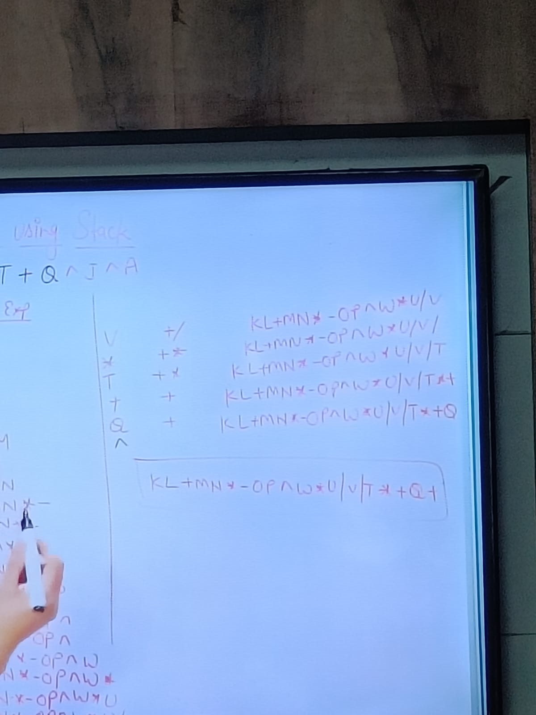

Slide 50
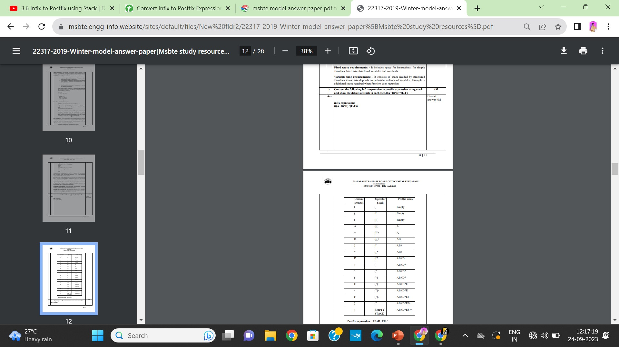

Slide 51
Conversion of Infix to Prefix.
Infix Expression: The expression of type a ‘operator’ b (a+b, where + is an operator) i.e., when the operator is between two operands.
Prefix Expression: The expression of type ‘operator’ a b (+ab where + is an operator) i.e., when the operator is placed before the operands.

Slide 52

How to do?
To convert an infix expression to a prefix expression, we can use the stack data structure. The idea is as follows:
Step 1: Reverse the infix expression. Note while reversing each ‘(‘ will become ‘)’ and each ‘)’ becomes ‘(‘.
Step 2: Convert the reversed infix expression to “nearly” postfix expression.
While converting to postfix expression, instead of using pop operation to pop operators with greater than or equal precedence, here we will only pop the operators from stack that have greater precedence.
Step 3: Reverse the postfix expression.
The stack is used to convert infix expression to postfix form.

Slide 53


Slide 54


Slide 55


Slide 56


Slide 57
Evaluation of prefix expression
One stack (call it Evaluation) holds the operators (like +, sin etc) and operands (like 3,4 etc) and the other stack (call it Count) holds a tuple of the number of operands left to be seen + the number of operands an operator expects. • Anytime you see an operator, you push the operator onto the Evaluation stack and push the corresponding tuple onto the Count stack. • Anytime you see an operand (like 3,5 etc), you check the top tuple of the Count stack and decrement the number of operands left to be seen in that tuple. • If the number of operands left to be seen becomes zero, you pop the tuple from the Count stack. Then from the Evaluation stack you pop off the number of operands required (you know this because of the other value of the tuple), pop off the operator and do the operation to get a new value, (or operand). • Now push the new operand back on the Evaluation stack. This new operand push causes you to take another look at the top of the Count stack and you do the same thing we just did (decrement the operands seen, compare with zero etc). • If the operand count does not become zero, you continue with the next token in the input.

Slide 58
Prefix Expression
In this notation, operator is prefixed to operands, i.e. operator is written ahead of operands. For example, +ab. This is equivalent to its infix notation a + b. Prefix notation is also known as Polish Notation.
Example:
* + 6 9 - 3 1
Prefix expressions are evaluated faster than infix expressions. Also, there are no brackets in prefix expressions which make it evaluate quicker.
Algorithm to evaluate Prefix Expression:
The evaluation of prefix expression requires a stack data structure. We will push the operators in the stack and then solve the expression.
We will visit each element of the expression one by one. If the current element is an operand, we will push it to the stack. And if it is an operator, we will pop two operands, perform the operation, operand operator operand and then push the result back to the stack.

Slide 59
Algorithm −
Step 1: Start from the last element of the expression.
Step 2: check the current element.
Step 2.1: if it is an operand, push it to the stack. Step 2.2: If it is an operator, pop two operands from the stack. Perform the operation and push the elements back to the stack.
Step 3: Do this till all the elements of the expression are traversed and return the top of stack which will be the result of the operation.

Slide 60
Lets see the working of our algorithm to solve an prefix expression.
Prefix Expression :
* + 6 9 - 3 1
Iteration : 1
Element scanned => 1
Operation => push to stack Stack => 1
Iteration : 2
Element scanned => 3
Operation => push to stack Stack => 3 , 1
Iteration : 3
Element scanned => -
Operation => pop two from stack, perform operation and push back the result.
3 - 1 = 2 Stack => 2

Slide 61
Iteration : 4
Element scanned => 9
Operation => push to stack Stack => 9 , 2
Iteration : 5
Element scanned => 6
Operation => push to stack Stack => 6, 9 , 2
Iteration : 6
Element scanned => +
Operation => pop two from stack, perform operation and push back the result.
6 + 9 = 15
Stack => 15 , 2
Iteration : 7
Element scanned => *
Operation => pop two from stack, perform operation and push back the result.
15 * 2 = 30 Stack => 30
End => return top of stack, result = 30.

Slide 62


Slide 63


Done With STACKS!!!
Thank you !!!

Slide 64



QUEUES
Queue representation in memory using array
Queue as ADT
Types of Queues
Queue operations
Queue operation conditions.
Applications of queues.

Slide 65

What is Queue?
Queue is the data structure that is similar to the queue in the real world.
• A queue is a data structure in which whatever comes first will go out first, and it follows the FIFO (First-In-First-Out) policy.
• Queue can also be defined as the list or collection in which the insertion is done from one end known as the rear end or the tail of the queue,
• Whereas the deletion is done from another end known as the front end or the head of the queue.
• The real-world example of a queue is the ticket queue outside a cinema hall, where the person who enters first in the queue gets the ticket first, and the last person enters in the queue gets the ticket at last. Similar approach is followed in the queue in data structure.

Slide 66
Advantages & Disadvantages of Queue
Advantages of Queue
• A large amount of data can be managed efficiently with ease. • Operations such as insertion and deletion can be performed with ease as it follows the first in first out rule.
• Queues are useful when a particular service is used by multiple consumers.
• Queues are fast in speed for data inter-process communication.
• Queues can be used in the implementation of other data structures.
Disadvantages of Queue:
• The operations such as insertion and deletion of elements from the middle are time consuming.
• Limited Space.
• In a classical queue, a new element can only be inserted when the existing elements are deleted from the queue.
• Searching an element takes O(N) time.
• Maximum size of a queue must be defined prior.

Slide 67


Queue representation in memory using array
A queue can be efficiently represented in memory using an array. In this representation, you typically use two pointers: one for the front of the queue and another for the rear

Slide 68


Slide 69
Queue as Abstract Data Type (ADT),
A Queue, as an Abstract Data Type (ADT), is a linear data structure that follows the First-In-First-Out (FIFO) principle. It has two main operations: enqueue, which adds an element to the back of the queue, and dequeue, which removes an element from the front of the queue. Additionally, a queue ADT typically includes operations for checking if the queue is empty, finding its size, and peeking at the front element without removing it.
The definition of an ADT clearly states that for a data structure to be abstract . It should have two following charachterics –
There should ne a particular way in which components related to each other,
A statement of operations that can be performed on elements of the ADT should be specified.
Thus a queue an ADT , Can be defined as follows.
A queue of elements of type A is a finite sequence of elements A together with following operations.
Initialize a queue to be empty
Determine if a queue is empty or not
Insert a new element after the last element in a queue , if it is not full
Retrive the first element of a queue , if it is not empty
Delete the first element in queue , if it is not empty

Slide 70


Slide 71


Slide 72

n a simple queue, insertion takes place at the rear and removal occurs at the front. It strictly follows the FIFO (First in First out) rule.

Slide 73


Circular Queue
In a circular queue, the last element points to the first element making a circular link.
The main advantage of a circular queue over a simple queue is better memory utilization. If the last position is full and the first position is empty, we can insert an element in the first position. This action is not possible in a simple queue.

Slide 74


Slide 75


Slide 76


Slide 77


Slide 78


Slide 79


Slide 80




Operations performed on queue

Slide 81

Operation conditions
o Queue overflow (isfull): It shows the overflow condition when the queue is completely full.
o Queue underflow (isempty): It shows the underflow condition when the Queue is empty, i.e., no elements are in the Queue.

Slide 82
Application of queues
Job Scheduling: Operating systems use queues to manage processes and tasks in a fair and orderly manner. The CPU scheduler selects the next process to execute from the ready queue.
Print Queue: Print jobs sent to a printer are typically placed in a print queue. The printer processes them in the order they were added (FIFO), ensuring fairness.
Breadth-First Search (BFS): BFS uses a queue to traverse graphs level by level. It's used in graph algorithms, network routing, and web crawling.
Task Management: Task queues are used in concurrent programming and multitasking to manage threads or worker processes. Examples include thread pools and task queues in web servers.
Buffering: Queues are used to manage data between two asynchronous processes. For example, data can be read from a file or network into a queue and then processed by another part of the program.
Call Center Systems: In call centers, customer requests are typically managed in a queue. The next available customer service representative takes the next request from the queue.

Slide 83
7.Print Spooling: In addition to print queues, print spoolers use queues to store print jobs temporarily, allowing users to send multiple print jobs without waiting for each to finish.
8.Order Processing: In e-commerce systems, orders are often placed in a queue for processing. This ensures that orders are processed in the order they were received.
9.Bounded Buffers: Queues can be used to implement bounded buffers for producer-consumer scenarios, where data is produced and consumed asynchronously.
10. Caching: A cache implemented as a queue can store frequently accessed items. When the cache is full, the least recently used items are removed (like in an LRU cache).
ask Synchronization: Queues can be used for synchronization between threads or processes. For example, one thread can signal another thread to start a task by placing a message in a queue.
Event Handling: Event-driven systems often use queues to manage events. Events are placed in a queue, and event handlers process them one at a time.
Keyboard Input: In computer games and applications, keyboard input is often processed using a queue. Keystrokes are placed in a queue and processed sequentially.
Data Compression: In Huffman coding, a queue is used to build the Huffman tree, which is used for data compression.
Call Routing in Telecommunications: Queues are used in telecommunications to route calls to the appropriate destination, ensuring that calls are processed in order.

Slide 84

Difference between Stacks and Queues

Slide 85

Difference between Stacks and Queues

Slide 86


Slide 87


